Slide 1
Natural Language Processing
Università di Pisa
Giuseppe Attardi
Dipartimento di Informatica
Università di Pisa

Slide 2
Goal of NLP
Computers would be a lot more useful if they could handle our email, do our library research, chat to us …
But they are fazed by natural languages
Or at least their programmers are … most people just avoid the problem and get into XML, or menus and drop boxes, or …
Big challenge
How can we teach language to computers?
Or help them learn it as kids do?

Slide 3
NL: Science Fiction
Star Trek
universal translator: Babel Fish
Language Interaction

Slide 4
Early history of NLP: 1950s
Early NLP (Machine Translation) on machines less powerful than pocket calculators
Foundational work on automata, formal languages, probabilities, and information theory
First speech systems (Davis et al., Bell Labs)
MT heavily funded by military – a lot of it was just word substitution programs but there were a few seeds of later successes, e.g., trigrams
Little understanding of natural language syntax, semantics, pragmatics
Problem soon appeared intractable

Slide 5
Recent Breakthroughs
Watson at Jeopardy! Quiz:
http://www.aaai.org/Magazine/Watson/watson.php
Final Game
PBS report
Google Translate on iPhone
http://googleblog.blogspot.com/2011/02/introducing-google-translate-app-for.html
Apple SIRI

Slide 6
Smartest Machine on Earth
IBM Watson beats human champions at TV quiz Jeopardy!
State of the art Question Answering system

Slide 7
Apple SIRI
ASR (Automated Speech Recognition) integrated in mobile phone
Special signal processing chip for noise reduction
SIRI ASR
Cloud service for analysis
Integration with applications

Slide 8
Google Voice Actions
Google: what is the population of Rome?
Google: how tall is Berlusconi
How old is Lady Gaga
Who is the CEO of Tiscali
Who won the Champions League
Send text to Gervasi Please lend me your tablet
Navigate to Palazzo Pitti in Florence
Call Antonio Cisternino
Map of Pisa
Note to self publish course slides
Listen to Dylan

Slide 9
Technological Breakthrough
Machine learning
Huge amount of data
Large processing capabilities

Slide 10
Unreasonable Effectiveness of Data
Halevy, Norvig, and Pereira argue that we should stop acting as if our goal is to author extremely elegant theories, and instead embrace complexity and make use of the best ally we have: the unreasonable effectiveness of data.
A simpler technique on more data beat a more sophisticated technique on less data.
Language in the wild, just like human behavior in general, is messy.

Slide 11
Scientific Dispute: is it science
Prof. Noam Chomsky, Linguist, MIT
Peter Norvig, Director of research, Google

Slide 12
Chomsky
It's true there's been a lot of work on trying to apply statistical models to various linguistic problems. I think there have been some successes, but a lot of failures. There is a notion of success ... which I think is novel in the history of science. It interprets success as approximating unanalyzed data.
http://norvig.com/chomsky.html

Slide 13
Norvig
I agree that engineering success is not the goal or the measure of science. But I observe that science and engineering develop together, and that engineering success shows that something is working right, and so is evidence (but not proof) of a scientifically successful model.
Science is a combination of gathering facts and making theories; neither can progress on its own. I think Chomsky is wrong to push the needle so far towards theory over facts; in the history of science, the laborious accumulation of facts is the dominant mode, not a novelty. The science of understanding language is no different than other sciences in this respect.
I agree that it can be difficult to make sense of a model containing billions of parameters. Certainly a human can't understand such a model by inspecting the values of each parameter individually. But one can gain insight by examining the properties of the model—where it succeeds and fails, how well it learns as a function of data, etc.

Slide 14
Norvig (2)
Einstein said to make everything as simple as possible, but no simpler. Many phenomena in science are stochastic, and the simplest model of them is a probabilistic model; I believe language is such a phenomenon and therefore that probabilistic models are our best tool for representing facts about language, for algorithmically processing language, and for understanding how humans process language.
I agree with Chomsky that it is undeniable that humans have some innate capability to learn natural language, but we don't know enough about that capability to rule out probabilistic language representations, nor statistical learning. I think it is much more likely that human language learning involves something like probabilistic and statistical inference, but we just don't know yet.

Slide 15
Linguistic Analysis
Two reasons:
Exploiting digital knowledge
Communicating with computer assistants

Slide 16
Why to study human language?

Slide 17
AI is fascinating since it is the only discipline where the mind is used to study itself
Luigi Stringa, direttore FBK

Slide 18
Language and Intelligence
“Understanding cannot be measured by external behavior; it is an internal metric of how the brain remembers things and uses its memories to make predictions”.
“The difference between the intelligence of humans and other mammals is that we have language”.
Jeff Hawkins, “On Intelligence”, 2004

Slide 19
Hawkins’ Memory-Prediction framework
The brain uses vast amounts of memory to create a model of the world. Everything you know and have learned is stored in this model. The brain uses this memory-based model to make continuous predictions of future events. It is the ability to make predictions about the future that is the crux of intelligence.

Slide 20
More …
“Spoken and written words are just patterns in the world…
The syntax and semantics of language are not different from the hierarchical structure of everyday objects.
We associate spoken words with our memory of their physical and semantic counterparts.
Through language one human can invoke memories and create next justapositions of mental objects in another human.”

Slide 21
Thirty Million Words
The number of words a child hears in early life will determine their academic success and IQ in later life.
Researchers Betty Hart and Todd Risley (1995) found that children from professional families heard thirty million more words in their first 3 years
http://www.youtube.com/watch?v=qLoEUEDqagQ

Slide 22
Exploiting Knowledge
Reason 1

Slide 23
Scientia Potentia Est
But only if you know how to acquire it …
The Economist, May 8, 2003
Knowledge Management
Requires
Repositories of knowledge
Mechanism for using knowledge

Slide 24
Limitations of Desktop Metaphor
Reason 2

Slide 25
Personal Computing
Desktop Metaphor: highly successful in making computers popular
Benefits:
Point and click intuitive and universal
Limitations:
Point and click involves quite elementary actions
People are required to perform more and more clerical tasks
We have become: bank clerks, typographers, illustrators, librarians

Slide 26
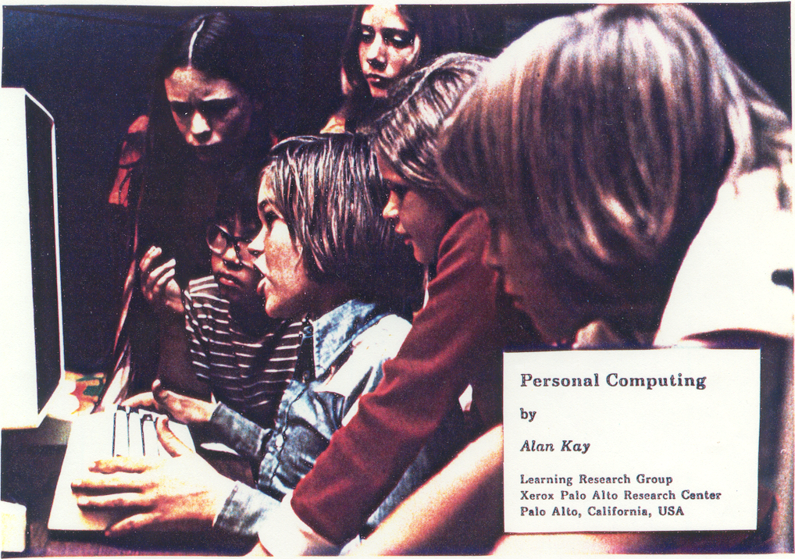

Slide 27
The DynaBook Concept

Slide 28
Kay’s Personal Computer
A quintessential device for expression and communication
Had to be portable and networked
For learning through experimentation, exploration and sharing

Slide 29
Alan Kay: Laurea ad honoris

Slide 30
An Ordinary Task
Add a table to a document with results from latest benchmarks and send it to my colleague Antonio
7-8 point&click just to get to the document
dozen point&click to get to the data
lengthy fiddling with table layout
3-4 point&click to retrieve mail address
etc.

Slide 31
Prerequisites
Declarative vs Procedural Specification
Details irrelevant
Many possible answers: user will choose best

Slide 32
Going beyond Desktop Metaphor
Could think of just one possibility:
Raise the level of interaction with computers
How?
Could think of just one possibility:
Use natural language

Slide 33
Linguistic Applications
So far self referential: from language to language
Classification
Extraction
Summarization
More challenging:
Derive conclusion
Perform actions

Slide 34
Natural Language Understanding is difficult
The hidden structure of language is highly ambiguous
Structures for: Fed raises interest rates 0.5% in effort to control inflation (NYT headline 5/17/00)
Slide by C. Manning

Slide 35
Where are the ambiguities?
Slide by C. Manning

Slide 36
Newspaper Headlines
Minister Accused Of Having 8 Wives In Jail
Juvenile Court to Try Shooting Defendant
Teacher Strikes Idle Kids
China to Orbit Human on Oct. 15
Local High School Dropouts Cut in Half
Red Tape Holds Up New Bridges
Clinton Wins on Budget, but More Lies Ahead
Hospitals Are Sued by 7 Foot Doctors
Police: Crack Found in Man's Buttocks

Slide 37
Reference Resolution
U: Where is The Green Hornet playing in Mountain View?
S: The Green Hornet is playing at the Century 16 theater.
U: When is it playing there?
S: It’s playing at 2pm, 5pm, and 8pm.
U: I’d like 1 adult and 2 children for the first show. How much would that cost?
Knowledge sources:
Domain knowledge
Discourse knowledge
World knowledge

Slide 38
NLP hard
Natural language is:
highly ambiguous at all levels
complex and subtle use of context to convey meaning
fuzzy?, probabilistic
involves reasoning about the world
a key part of people interacting with other people (a social system):
persuading, insulting and amusing them
But NLP can also be surprisingly easy sometimes:
rough text features can often do half the job

Slide 39
Hidden Structure of Language
Going beneath the surface…
Not just string processing
Not just keyword matching in a search engine
Search Google on “tennis racquet” and “tennis racquets” or “laptop” and “notebook” and the results are quite different … though these days Google does lots of subtle stuff beyond keyword matching itself
Not just converting a sound stream to a string of words
Like Nuance/IBM/Dragon/Philips speech recognition
To recover and manipulate at least some aspects of language structure and meaning

Slide 40
About the Course
Assumes some skills…
basic linear algebra, probability, and statistics
decent programming skills
willingness to learn missing knowledge
Teaches key theory and methods for Statistical NLP
Useful for building practical, robust systems capable of interpreting human language
Experimental approach:
Lots of problem-based learning
Often practical issues are as important as theoretical niceties

Slide 41
Experimental Approach
Formulate Hypothesis
Implement Technique
Train and Test
Apply Evaluation Metric
If not improved:
Perform error analysis
Revise Hypothesis
Repeat

Slide 42
Program
Introduction
History
Present and Future
NLP and the Web
Mathematical Background
Probability and Statistics
Language Model
Hidden Markov Model
Viterbi Algorithm
Generative vs Discriminative Models
Linguistic Essentials
Part of Speech and Morphology
Phrase structure
Collocations
n-gram Models
Word Sense Disambiguation
Preprocessing
Encoding
Regular Expressions
Segmentation
Tokenization
Normalization

Slide 43
NLTK
Introduction to Python
Overvies of NLTK libraries
Classification
Machine Learning
Statistical classifiers
Bayesan Network
Perceptron
Maximum Entropy
Support Vector Machines
Hidden Variable Models
Clustering
K-means
Factored Models
Singular Value Decomposition
Latent Semantic Indexing

Slide 44
Tagging
Part of Speech
Named Entity
Super Senses
Sentence Structure
Constituency Parsing
Dependency Parsing
Semantic Analysis
Semantic Role Labeling
Coreference resolution
Statistical Machine Translation
Word-Based Models
Phrase-Based Models
Decoding
Syntax-Based SMT
Evaluation metrics

Slide 45
Processing Pipelines
Integrated tooolkit
Frameworks
Gate
UIMA
Data Pipeline
Tanl
Applications
Information Extraction
Information Filtering
Recommender System
Opinion Mining
Semantic Search
Question Answering
Text Entailment

Slide 46
Exam
Project

Slide 47
PreviousYear Projects
Participation to Evalita 2011
Task POS + Lemmatization: 1st position
Task Domain Adaptation: 1st position
Task SuperSense: 1st position
Task Dependency Parsing: 2nd position
Task NER: 3rd position
SemEval 2012
Sentiment Analysis on tweets

Slide 48
Books
C. Manning, H. Schutze. Foundations of Statistical Natural Language Processing. MIT Press, 2000.
D. Jurafsky, J.H. Martin, Speech and Language Processing. 2nd edition, Prentice-Hall, 2008.
S. Kubler, R. McDonald, J. Nivre. Dependency Parsing. 2010.
P. Koehn. Statistical Machine Translation. Cambridge University Press, 2010.
S. Bird, E. Klein, E. Loper. Natural Language Processing with Python

