Slide 1
Deep Learning NL
Giuseppe Attardi Dipartimento di Informatica Università di Pisa

Slide 2
Statistical Machine Learning
Training on large document collections
Requires ability to process Big Data
If we used same algorithms 10 years ago they would still be running
The Unreasonable Effectiveness of Big Data

Slide 3
Supervised Statistical ML Methods
Devise a set of features to represent data:
φ(x) ∈ R^{D} and weights w_{k} ∈ R^{D}
Objective function
f(x) = argmax_{k} w_{k} φ(x)
Minimize error wrt training examples
Freed us from devising rules or algorithms
Required creation of annotated training corpora
Imposed the tyranny of feature engineering

Slide 4
Deep Neural Network Model
Output layer
Prediction of target
Hidden layers
Learn more abstract representations
Input layer
Raw input
…
…
…
…

Slide 5
Deep Learning Breakthrough: 2006
Unsupervised learning of shallow features from large amounts of unannotated data
Features are tuned to specific tasks with second stage of supervised learning

Slide 6
Supervised Fine Tuning
Should be: 2
Output: f(x)
Courtesy: G. Hinton

Slide 7
Vector Representation of Words
From discrete to distributed representation
Word meanings are dense vectors of weights in a high dimensional space
Algebraic properties
Background
Philosophy: Hume, Wittgenstein
Linguistics: Firth, Harris
Statistics ML: Feature vectors
”You shall know a word by the company it keeps”
(Firth, 1957).

Slide 8
Distributional Semantics
Co-occurrence counts
High dimensional sparse vectors
Similarity in meaning as vector similarity
 | shining | bright | trees | dark | look
stars | 38 | 45 | 2 | 27 | 12
tree
stars
sun

Slide 9
Co-occurrence Vectors
FRANCE 454 | JESUS 1973 | XBOX 6909 | REDDISH 11724 | SCRATCHED 29869 | MEGABITS 87025
PERSUADE | THICKETS | DECADENT | WIDESCREEN | ODD | PPA
FAW | SAVARY | DIVO | ANTICA | ANCHIETA | UDDIN
BLACKSTOCK | SYMPATHETIC | VERUS | SHABBY | EMIGRATION | BIOLOGICALLY
GIORGI | JFK | OXIDE | AWE | MARKING | KAYAK
SHAFFEED | KHWARAZM | URBINA | THUD | HEUER | MCLARENS
RUMELLA | STATIONERY | EPOS | OCCUPANT | SAMBHAJI | GLADWIN
PLANUM | GSNUMBER | EGLINTON | REVISED | WORSHIPPERS | CENTRALLY
GOA’ULD | OPERATOR | EDGING | LEAVENED | RITSUKO | INDONESIA
COLLATION | OPERATOR | FRG | PANDIONIDAE | LIFELESS | MONEO
BACHA | W.J. | NAMSOS | SHIRT | MAHAN | NILGRIS
neighboring words are not semantically related

Slide 10
Techniques for Creating Word Embeddings
Collobert et al.
SENNA
Polyglot
DeepNL
Mikolov et al.
word2vec
Lebret & Collobert
DeepNL
Socher & Manning
GloVe

Slide 11
Neural Network Language Model
LM likelihood
Expensive to train:
3-4 weeks on Wikipedia
U
Word vector
the cat sits on
… cat …
LM prediction
Quick to train:
40 min.on Wikipedia
tricks:
parallelism
avoid synchronization
U
Σ
the sits on

Slide 12
Lots of Unlabeled Data
Language Model
Corpus: 2 B words
Dictionary: 130,000 most frequent words
4 weeks of training
Parallel + CUDA algorithm
40 minutes

Slide 13
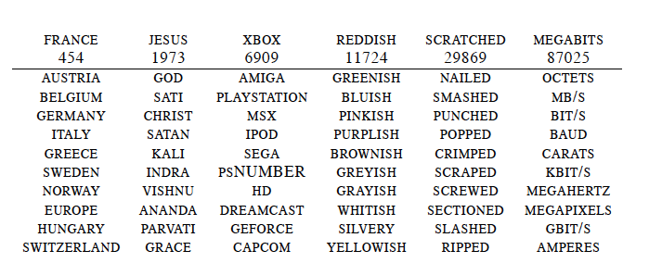
Word Embeddings
neighboring words are semantically related

Slide 14
Back to Co-occurrence Counts
$$P\left(w_{t}, w_{t−i}…w_{t−1}\right)=\frac{P(w_{t}, w_{t−i}…w_{t−1})}{P(w_{t−i}…w_{t−1})}$$
 | breeds | computing | cover | food | is | meat | named | as
cat | 0.04 | 0.0 | 0.0 | 0.13 | 0.53 | 0.02 | 0.16 | 0.1
dog | 0.11 | 0.0 | 0.0 | 0.12 | 0.39 | 0.06 | 0.18 | 0.17
cloud | 0/0 | 0.29 | 0.19 | 0.0 | 0.12 | 0.0 | 0.0 | 0.4
Big matrix |V| × |V| (~ 100k × 100k)
Dimensionality reduction:
Principal Component Analysis, Hellinger PCA, SVD
Reduce to:100k × 50, 100k × 100

Slide 15
Weighting
Weight the counts using corpus-level statistics to reflect
co-occurrence significance
Pointwise Mutual Information
$$PMI\left(w_{t}, w_{t−i}…w_{t−1}\right)= \log{\frac{P(w_{t}, w_{t−i}…w_{t−1})}{P\left(w_{t}\right)P(w_{t}, w_{t−i}…w_{t−1})}}$$

Slide 16
Online Demos
Polyglot
Attardi
Lebret

Slide 17
Applications
NER
IMDB Movie Reviews
Approach | F1
Ando et al. 2005 | 89.31
Word2Vec | 88.20
GloVe | 88.30
SENNA | 89.51
Model | Accuracy
Wang & Manning | 91.2
Brychcin & Habernal | 92.2
H-PCA | 89.9

Slide 18
Visualizing Embeddings
t-SNE: tool for visualization of high-dimensional dataset

Slide 19
Deep Learning for NLP

Slide 20
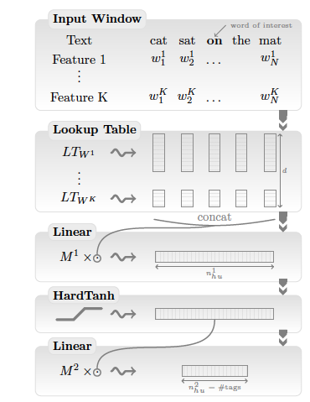
A Unified Deep Learning Architecture for NLP
NER (Named Entity Recognition)
POS tagging
Chunking
Parsing
SRL (Semantic Role Labeling)
Sentiment Analysis

Slide 21
Creating the Embeddings

Slide 22
Obtain Text Corpora
Wikipedia
Get XML dumps from:
http://download.wikimedia.org/
Get WikiExtractor from:
http://medialab.di.unipi.it/wiki/Wikipedia_Extractor
Extract the text:
WikiExtractor.py -o text itwiki-latest-pages-articles.xml.bz2

Slide 23
Sentence splitting and tokenization
NLTK
Punkt sentence splitter
import nltk.data
splitter = nltk.data.load('tokenizers/punkt/english.pickle')
for line in file:
for sent in splitter.tokenize(line.strip()):
print sent
Tokenizer
tokenizer = splitter._lang_vars. word_tokenize
print ' '.join(tokenizer(sent))
Normalize (optional)
Convert to lowercase
Replace digits with '0'

Slide 24
Create Embeddings
word2vec
Download and compile:
> svn checkout http://word2vec.googlecode.com/svn/trunk/ word2vec
> cd word2vec
> make
Run
> word2vec word2vec -train train.txt -output vectors.txt
-cbow 1 -size 50 -window 5 -min-count 40 -negative 0
-hs 1 -sample 1e-3 -threads 24 -debug 0

Slide 25
Sequence Taggers

Slide 26
Train POS Tagger
Input: tab separated token/tag, one per line
Mr. NNP
Vinken NNP
is VBZ
chairman NN
of IN
Elsevier NNP
> dl-pos.py pos.dnn -t wsj.pos --vocab vocab.txt --vectors vectors.txt --caps --suffixes suffix.list -w 5 -n 300 –e 10

Slide 27
Test POS Tagger
> dl-pos.py pos.dnn < input.tokens

Slide 28
Train NER Tagger
Input in Conll03 tab separated format:
EU NNP I-NP I-ORG
rejects VBZ I-VP O
German JJ I-NP I-MISC
call NN I-NP O
to TO I-VP O
boycott VB I-VP O
British JJ I-NP I-MISC
lamb NN I-NP O
> dl-ner.py ner.dnn -t wsj.conll03
--vocab vocab.txt --vectors vectors.txt --caps --suffixes suffix.list -w 5 -n 300
–e 10 --gazetteer entities.list

Slide 29
Perform NER Tagging
> dl-ner.py ner.dnn < input.file

Slide 30
Train Dependency Parser
Configuration file:
Features FORM -1 0 1
Features LEMMA -1 0 1 prev(0) leftChild(0) rightChild(0)
Features POSTAG -2 -1 0 1 2 3 prev(0) leftChild(-1) leftChild(0)
Features CPOSTAG -1 0 1 rightChild(0) rightChild(rightChild(0))
Features FEATS -1 0 1
Features DEPREL leftChild(-1) leftChild(0) rightChild(-1)
Feature CPOSTAG(-1) CPOSTAG(0)
Feature CPOSTAG(0) CPOSTAG(1)
if(POSTAG(0) = "IN", LEMMA(0)) LEMMA(last(POSTAG, "V"))
> desr -c conf -t -m model train.corpus
Linguistic feature: use lemma of last verb if current word is preposition

Slide 31
Perform Dependency Parsing
> desr -m model < input.conll

Slide 32
Evaluate Dependency Parser
> eval09.py –g gold.file –s system.file

Slide 33
Parser Online Demo

Slide 34
Annotating, Visualizing Dependencies
DgaAnnotator
Brat Rapid Annotation Tool

Slide 35
Code Base
NLPNET
https://github.com/attardi/nlpnet
DeepNL
https://github.com/attardi/deepnl
DeSR parser
https://sites.google.com/site/desrparser/

Slide 36
Limits of Word Embeddings
Limited to words (neither MW nor phrases)
Represent similarity: antinomies often appear similar
Not good for sentiment analysis
Not good for polysemous words
Solution
Semantic composition
or …

Slide 37
Recursive Neural Networks
Tina likes tigers
likes tigers
Tina
likes
tigers

Slide 38
Sense Specific Word Embeddings
Sentiment Specific Word Embeddings
Uses an annotated corpus with polarities (e.g. tweets)
SS Word Embeddings achieve SOTA accuracy on tweet sentiment classification
LM likelihood + Polarity
U
the cat sits on

Slide 39
Context Aware Word Embeddings
LM likelihood
U
W
Σ
the cat sits on
Applications:
Word sense disambiguation
Document Classification
Polarity detection
Adwords matching

Slide 40
References
R. Collobert et al. 2011. Natural Language Processing (Almost) from Scratch. Journal of Machine Learning Research, 12, 2461–2505.
Q. Le and T. Mikolov. 2014. Distributed Representations of Sentences and Documents. In Proc. of the 31st International Conference on Machine Learning, Beijing, China, 2014. JMLR:W&CP volume 32.
Rémi Lebret and Ronan Collobert. 2013. Word Embeddings through Hellinger PCA. Proc. of EACL 2013.
O. Levy and Y. Goldberg. 2014. Neural Word Embeddings as Implicit Matrix Factorization. In Advances in Neural Information Processing Systems (NIPS).
T. Mikolov, K. Chen, G. Corrado, and J. Dean. 2013. Efficient Estimation of Word Representations in Vector Space. In Proceedings of Workshop at ICLR, 2013.
Tang et al. 2014. Learning Sentiment-SpecificWord Embedding for Twitter Sentiment Classification. In Proc. of the 52nd Annual Meeting of the ACL, 1555–1565,

