Slide 1
A new era:
Topic-based Annotators

Slide 2
Classical approach
“Diego Maradona won against Mexico”
Dictionary of terms
against
Diego
Maradona
Mexico
won
Term Vector
Vector Space model
2.2
5.1
9.1
1.0
0.1
t₃
v
α
w
t₂
t₁
Similarity(v,w) ≈ cos(α)
Mainly term-based:
polysemy and synonymy issues

Slide 3
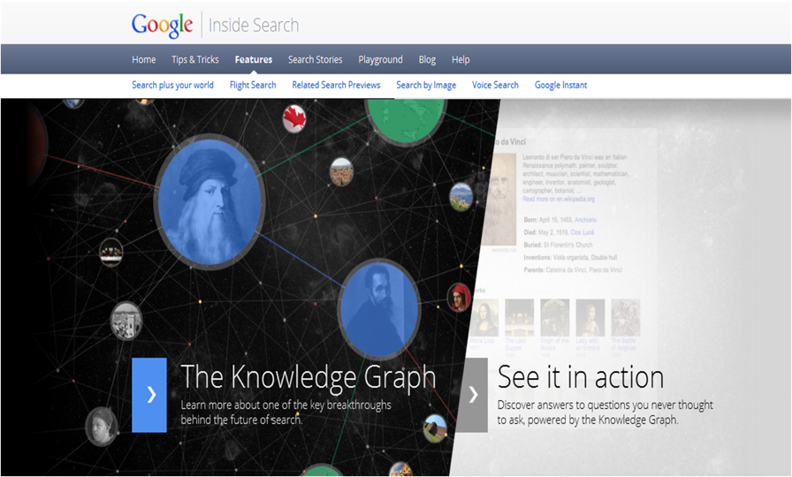
A new approach:
Massive graphs of entities and relations
May 2012
3

Slide 4
A typical issue: polysemy
the paparazzi photographed the star
the astronomer photographed the star

Slide 5
Another issue: synonymy
He is using Microsoft’s browser
He is a fan of Internet Explorer

Slide 6
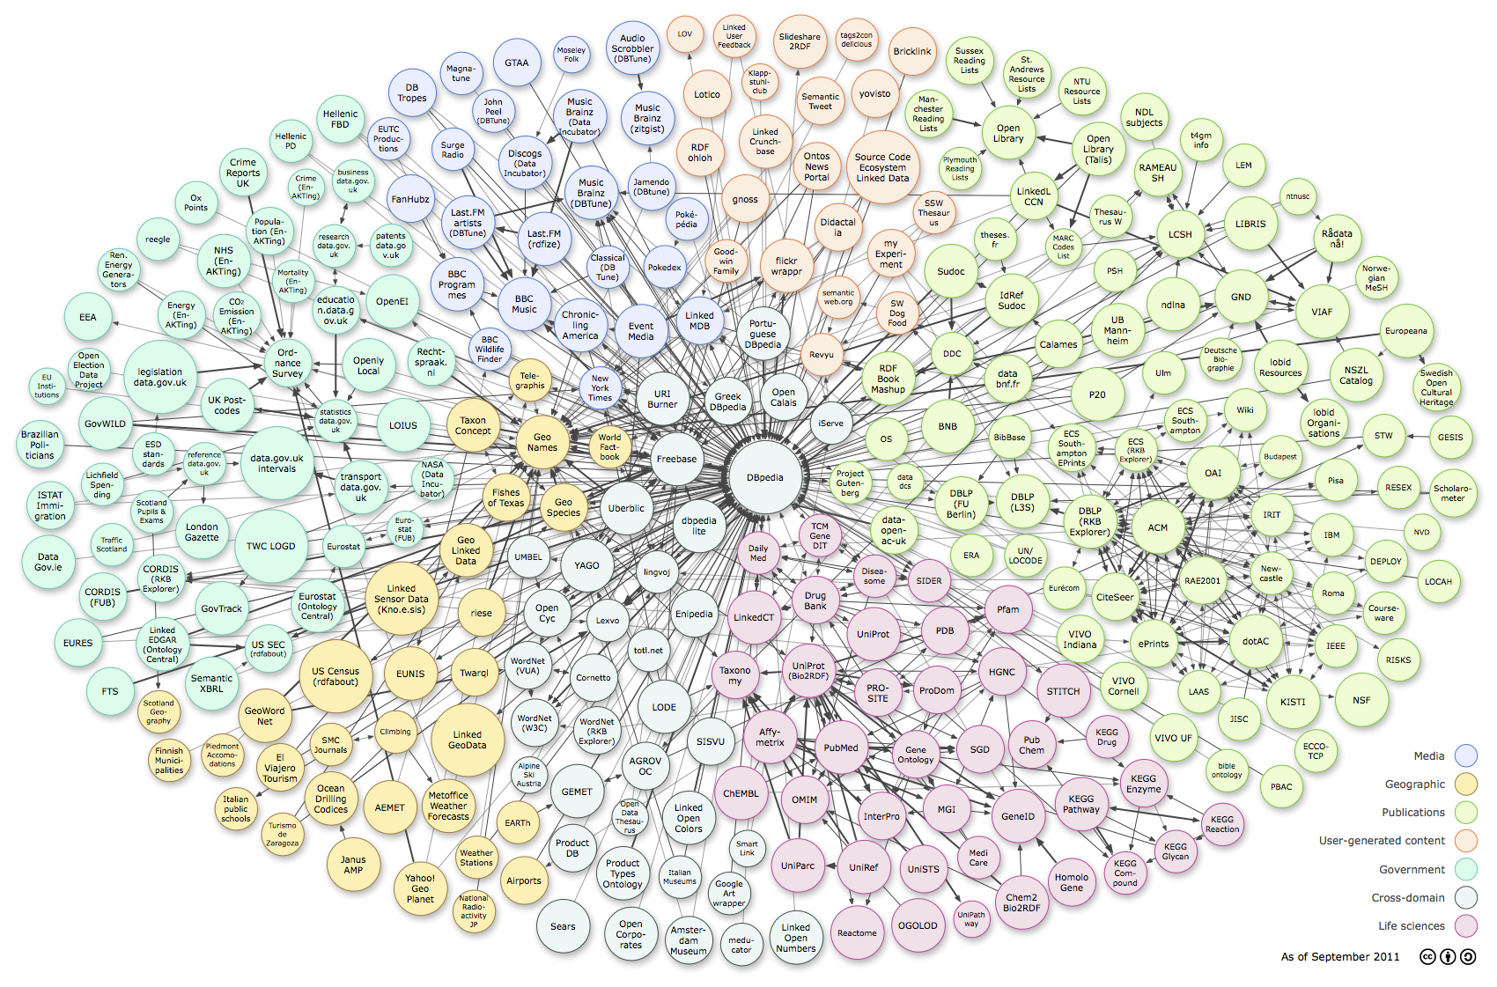













Web of Data: RDF, Tables, Microdata
Cyc
6
http://richard.cyganiak.de/2007/10/lod/lod-datasets_2011-09-19_colored.png
Thanks to G. Weikum, SIGMOD 2013

Slide 7
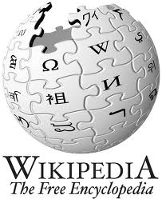
Web of Data: RDF, Tables, Microdata
4M entities in
250 classes
500M facts for
6000 properties
live updates
10M entities in
350K classes
120M facts for
100 relations
100 languages
95% accuracy
25M entities in
2000 topics
100M facts for
4000 properties
powers Google
knowledge graph
http://richard.cyganiak.de/2007/10/lod/lod-datasets_2011-09-19_colored.png
7
Thanks to G. Weikum, SIGMOD 2013

Slide 8

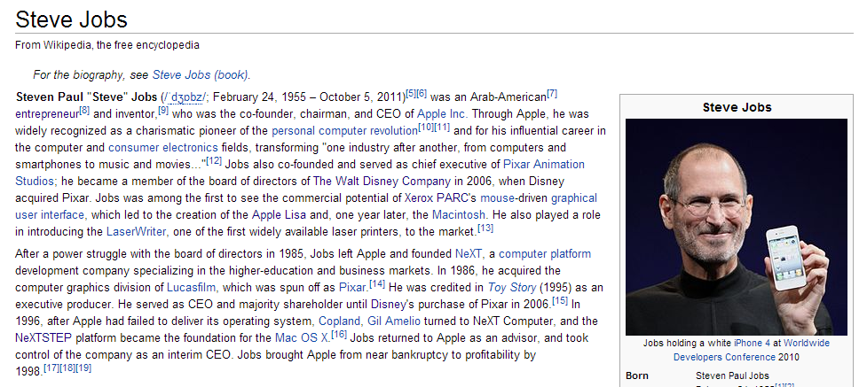

Wikipedia is a rich source of instances

Slide 9
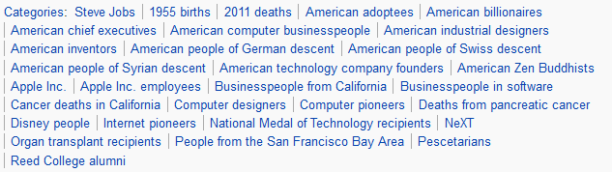
Wikipedia's categories contain classes
Categories form a taxonomic DAG (not really…)

Slide 10
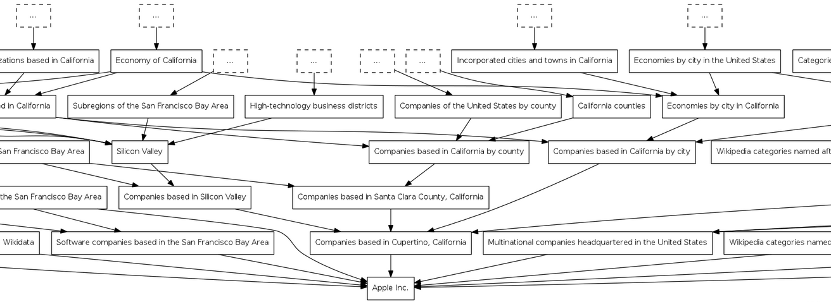
DAG of categories: http://toolserver.org/~dapete/catgraph/
10

Slide 11
A new approach:
Topic-based annotation
“Diego Maradona won against Mexico”
Mexico’s football team
Ex-Argentina’s player
anchors
Find mentions and annotate them
with topics drawn from a catalog
articles
Wikipedia!

Slide 12

Polysemy
Celebrity is a person who is famou-sly recognized …
the paparazzi photographed the star
the astronomer photographed the star
Star is a massive, luminous ball of plasma …

Slide 13
Why is it a difficult problem?
“Diego Maradona won against Mexico”
Ex-Argentina’s coach
His nephew
Maradona Stadium
Maradona Movie
…
Mexico nation
Mexico state
Mexico football team
Mexico baseball team
…
Don’t annotate!

Slide 14
Features used by annotators
Commonness of a page
p wrt an anchor a
Context of a around the mention and within a page/entity p
mention = …w₁ w₂ w₃ a w₄ w₅ w₆ …
page/entity p = …z₁ z₂ z₃ z₄ z₅ z₆ …
Link probability of an anchor a
Graph-based features
a is a mention-node
p is an entity-node
Links a ◻ p and paths between pages

Slide 15
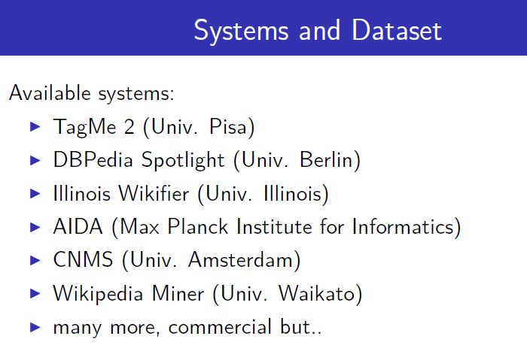
The literature
Many commercial software: AlchemyAPI, DBpedia Spotlight, Extractiv, Lupedia, OpenCalais, Saplo, SemiTags, TextRazor, Wikimeta, Yahoo! Content Analysis, Zemanta.

Slide 16


[Ferragina-Scaiella, CIKM 2010]
tagme.di.unipi.it
Designed for short texts
  news, blogs, search-results snippets, tweets, ads, etc
  competitive on long texts too
Achieves high accuracy
  Massive experimental test on millions of short texts
Fast
  More than 10x faster than others
  100% Java

Slide 17
How TAGME works
“Diego Maradona won against Mexico”
Diego A. Maradona
Diego Maradona jr.
Maradona Stadium
Maradona Film
…
…
Mexico nation
Mexico state
Mexico football team
Mexico baseball team
…
…
No Annotation
DISAMBIGUATION
by a voting scheme
PRUNING
2 simple features
PARSING

Slide 18
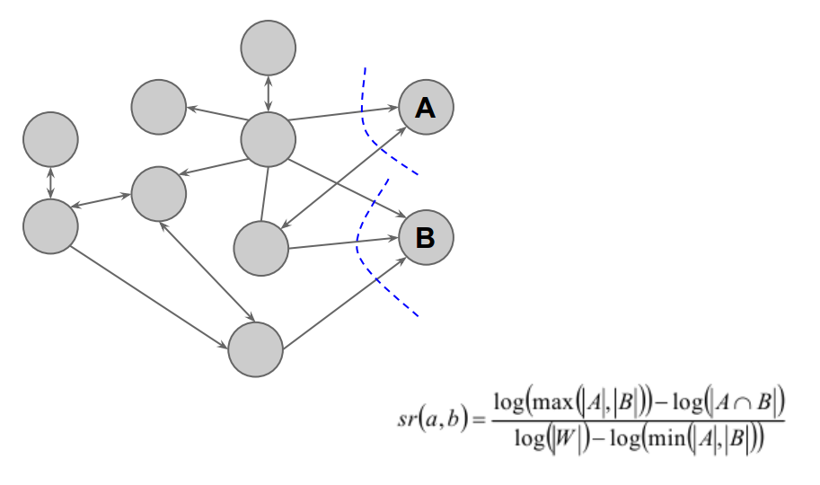
Relatedness between pages

Slide 19
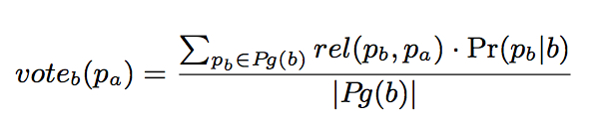
Disambiguation: The voting scheme
Collective agreement among topics via voting
“Diego Maradona won against Mexico”
b
a
p_{b}
Diego A. Maradona
Diego Maradona jr.
Maradona Stadium
Maradona Film
…
Wiki-articles | Votes
Mexico | 0.09
State of Mexico | 0
Mexico National Football Team | 0.29
Mexico National Baseball Team | 0
p_{a}

Slide 20
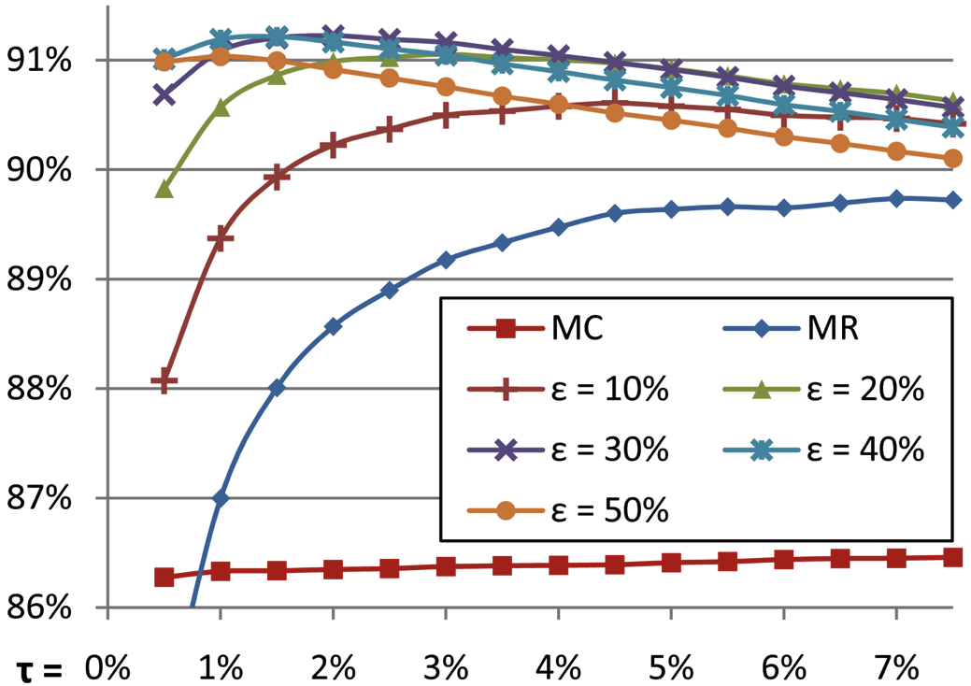
Disambiguation: all steps
τ = trade-off
speed vs. recall
Commonness of a page
p wrt an anchor a
Pruning by commonness < τ
Voting scheme
Select top-ε pages
Select the best in commonness

Slide 21
Pruning
We use 2 features:
  link probability
  coherence wrt context
Compute a ρ score via
  3 classifiers, avg, linear combination
  if ρ < ρ_{NA} then prune!
Link probability of an anchor a
Avg. relatedness btw the assigned concept to the others
balance
precision vs. recall

Slide 22
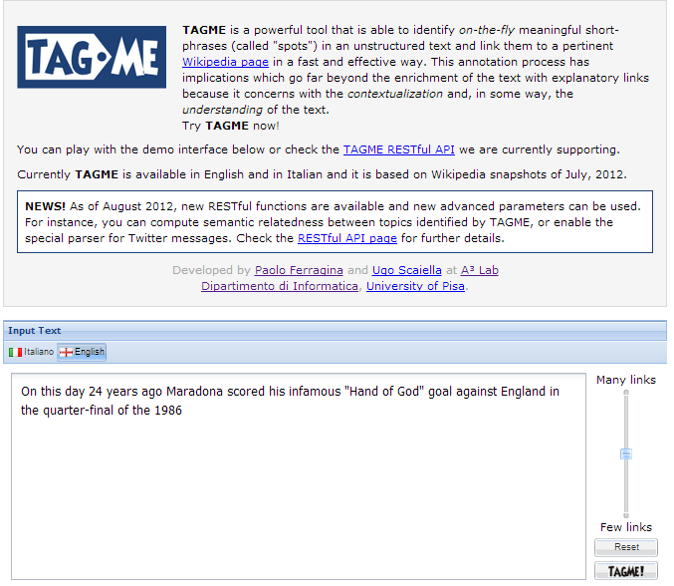

Slide 23
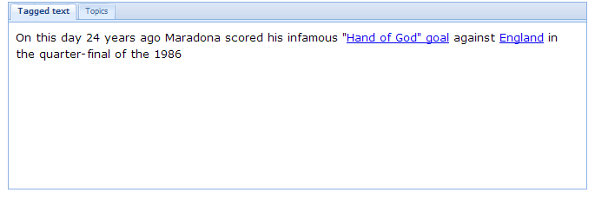
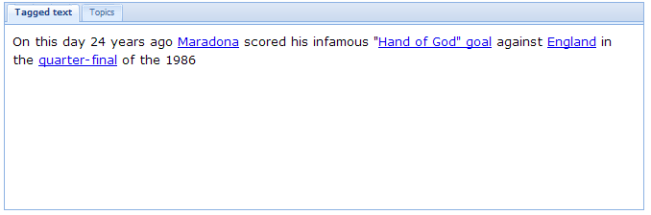
Less links
More links

Slide 24
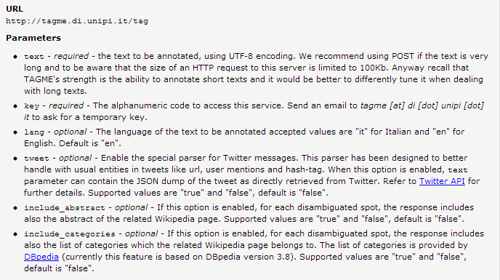
Tagging → Json

Slide 25
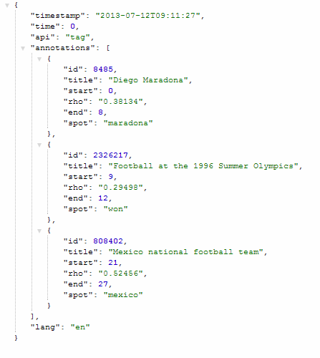
http://tagme.di.unipi.it/tag?text=maradona%20won%20against%20mexico&key=***
Useful for relating topics
NLP ?

Slide 26
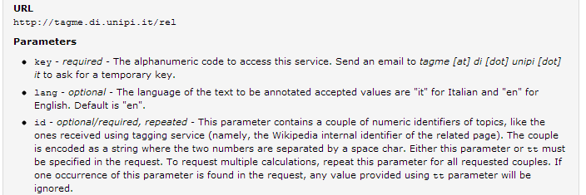
Relating topics
http://tagme.di.unipi.it/rel?id=8485%20615883&key=***
Maradona vs Totti
0,8157

Slide 27
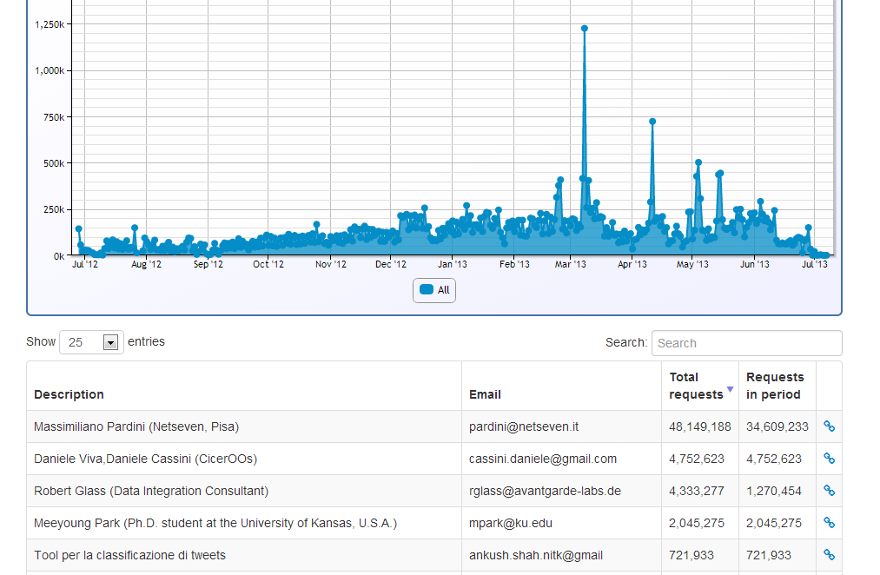
We surpassed 100 Mln query
Tweet Classification

Slide 28
On comparing annotators
[Cornolti et al, WWW 2013]

Slide 29
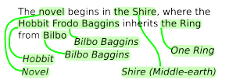

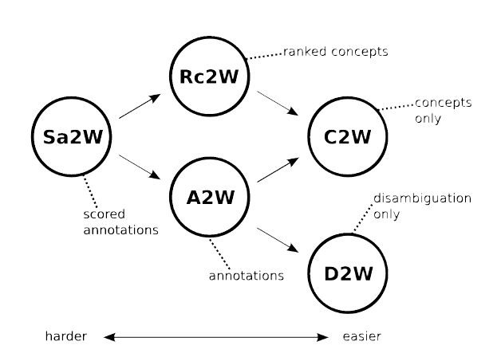
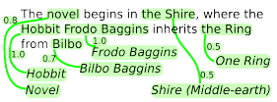
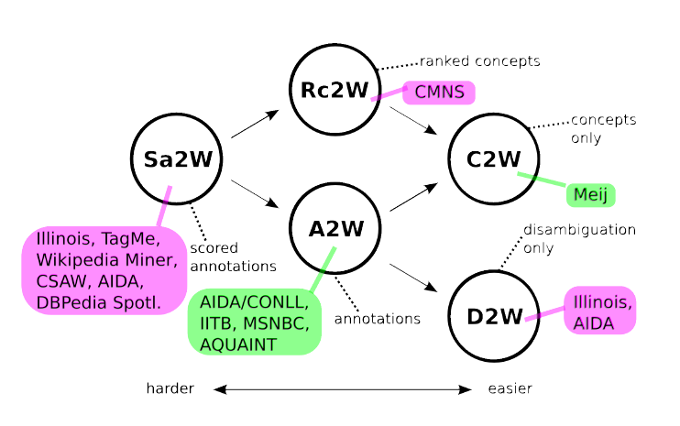

A word of caution !
A2W
Sa2W
Rc2W

Slide 30
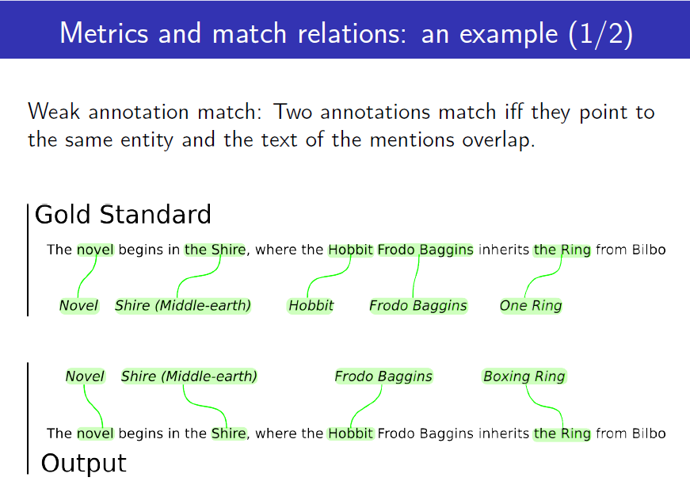

Slide 31
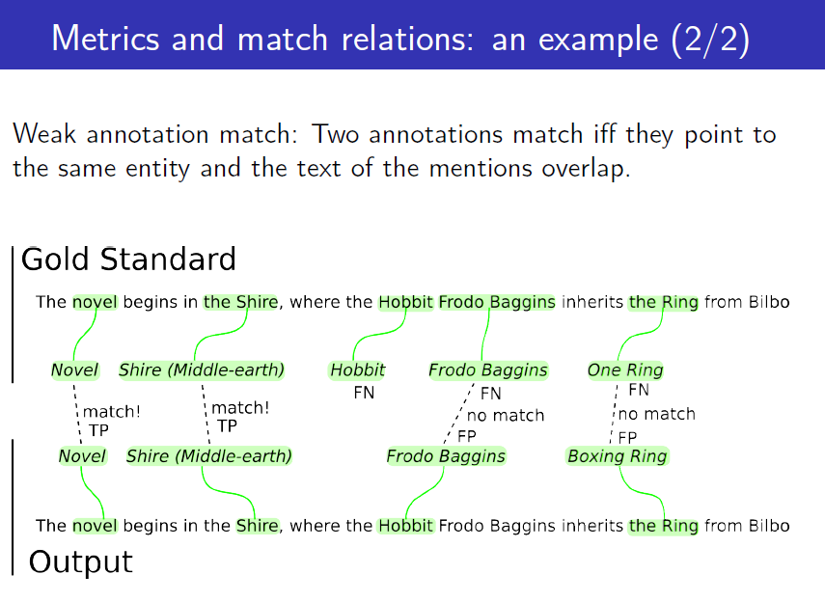

Slide 32
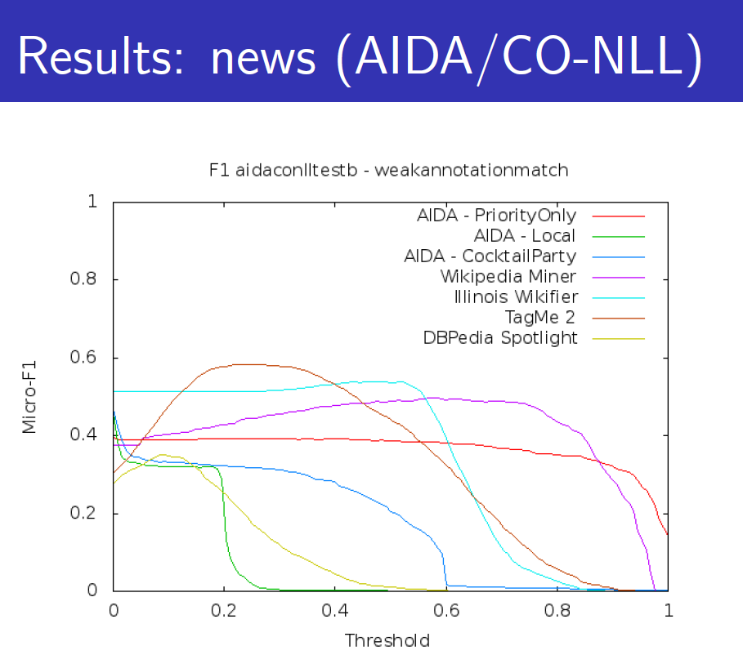
Weak annotation match
(same entity & mention overlap)
Your project should pump up TAGME’s curve

Slide 33
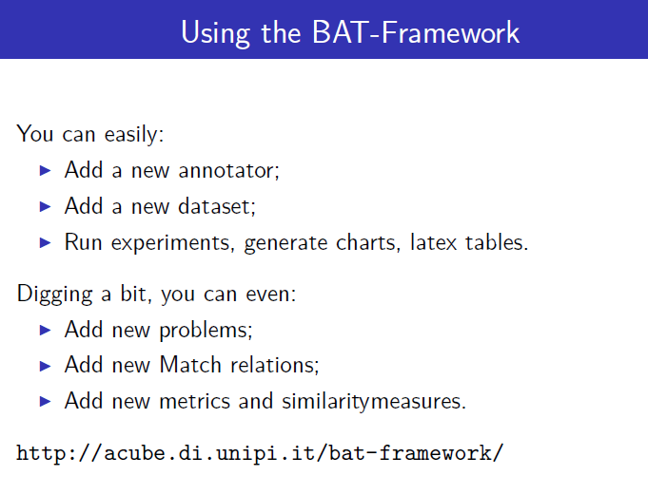

Slide 34
Other approaches to topic-based annotation

Slide 35
Goal
Mentions = Anchor Texts
Entities = Wikipedia Pages
50
30
50
20
30
10
10
90
100
30
80
20
90
100
90
5
30
Main goal:
each mention is connected to at most one entity
35
Thanks to G. Weikum, SIGMOD 2013

Slide 36
Probability Factor Graph
Mentions = Anchor Texts
Entities = Wikipedia Pages
50
30
50
20
30
10
10
90
100
30
80
20
90
100
90
5
30
Collective Learning with Probabilistic Factor Graphs
[Chakrabarti et al.: KDD’09]
  model P[m|e] by similarity and P[e1|e2] by coherence
  consider likelihood of P[m1 … mk|e1 … ek]
  factorize by all m-e pairs and e1-e2 pairs
  use hill-climbing, LP etc. for solution
36
Thanks to G. Weikum, SIGMOD 2013

Slide 37
Dense Subgraph
Mentions = Anchor Texts
Entities = Wikipedia Pages
50
30
50
20
30
10
10
90
100
30
80
20
90
100
90
5
30
Compute dense subgraph such that:
each mention is connected to at most one entity
ML and classification (possibly based on unambiguous entities)
[Bunescu/Pasca 2006, Cucerzan 2007, Milne/Witten 2008, …]
37
Thanks to G. Weikum, SIGMOD 2013

Slide 38
Coherence Graph Algorithm
140
50
30
50
20
180
30
10
10
60
90
100
30
30
470
90
80
100
145
90
5
30
240
Compute dense subgraph such that:
each mention is connected toat most one entity
GOAL: maximize min weighted degree among entity nodes
Greedy approximation:
iteratively remove weakest entity and its edges
[Weikum et al. 2011]

Slide 39
Random Walks
ε
0.5
50
ε
0.83
0.3
50
30
0.2
20
0.23
ε
0.1
0.17
30
10
10
0.7
90
0.77
100
0.25
30
0.2
ε
0.4
20
0.75
80
90
0.75
0.96
90
100
ε
0.15
0.04
30
5
ε
for each mention run personalized PageRank with restart
rank entity e by stationary visiting probability, starting from m
39
Thanks to G. Weikum, SIGMOD 2013

Slide 40
Is it just a matter of “annotation” ?

Slide 41
BOW-representation
t₃
cos(α) = v • w / ||v|| * ||w||
d₂
α
d₁
d₅
t₁
t₂

Slide 42
Enrich the BOW-representation
T = {w₁…w_{n}} be input text
<tfidf_{i}> be its TFIDF weight of word w_{i}
Wikipedia concept/entity c_{j}
<k_{ij}> quantifies the strength of association of word w_{i} with Wikipedia concept c_{j}
No annotators, just search in Wikipeda

Slide 43
Explicit Semantic Analysis
[Gabrilovitch et al, IJCAI 07]
the semantic vector V for text T is defined as
weight(c_{j}) = Sum_{w_{i} ∈ T} TFIDF_{i} * rel(w_{i},c_{j})
To compute semantic relatedness of a pair of texts we compare their vectors using the cosine metric
Yet vector space model

Slide 44
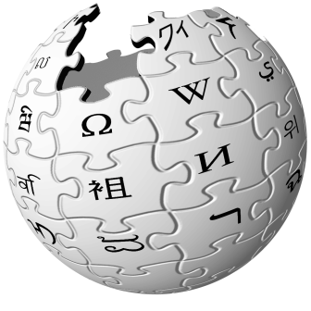
A new representation
obama says gaddafi may way out military assault
Barack Obama
Muammar
al-Gaddafi
Offensive
(military)
Q: how to measure proximity of nodes
President of the
United States
Libya
Ultimatum
us president issues libya ultimatum

Slide 45

Text as a sub-graph of topics
Barack Obama
President of the United States
Mahmoud Ahmadinejad
Iran
Ultimatum
RQ-170 drone
Graph analysis allows to find similarities between texts and entities even if they do not match syntactically (so at concept level)
Any relatedness measure over a graph, e.g. [Milne & Witten, 2008]

Slide 46
Annotators and Random walks
Given two texts, we map them to two sets of nodes/entities
  We stick onto the graph representation
Graph-KB of concepts
Text 1
Volumes
of random paths
Text 2

Slide 47
Some applications of this novel text representation

Slide 48
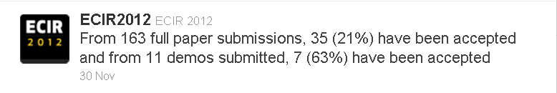
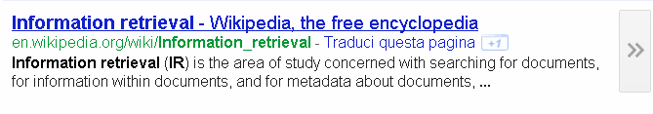
Text Categorization
It is the problem of labeling natural language texts with one or more thematic categories drawn from a predefined set.
Many solutions for long texts
  Naive Bayes, SVM, k-NN, MaxEnt, Decision Tree…
few for short texts

Slide 49

Topical classification of news
No vector space
Training (given a set of classes)
Annotate the training-set using TAGME
For each class i, create a subset of topics t_{z} by importance and distinctiveness over all training-set
Test
Annotate the text to be classified using TAGME
Classify the text by computing the ρ−weighted relatedness between any text-topic with the subset of topics assigned to each category (ρ of topic in text).

Slide 50
Example
SPORT
SCI-TECH
BUSINESS
HEALTH
....
Rafael Nadal
World Wide Web
Eurozone
Patient
Coach (sport)
NASA
Stock
Infants
NBA Playoffs
web search engine
Federal Reserve
Cholesterol
Roger Federer
Planet
Wall Street
HIV
…
…
…
…
Francesca Schiavone won Roland Garros
SPORT
Francesca Schiavone
French Open
Relatedness measure

Slide 51
Some experiments
Categories
Sport
Business
U.S.
Health
Sci&Tech
World
Entertainment
32K items from 3 RSS news-feeds

Slide 52
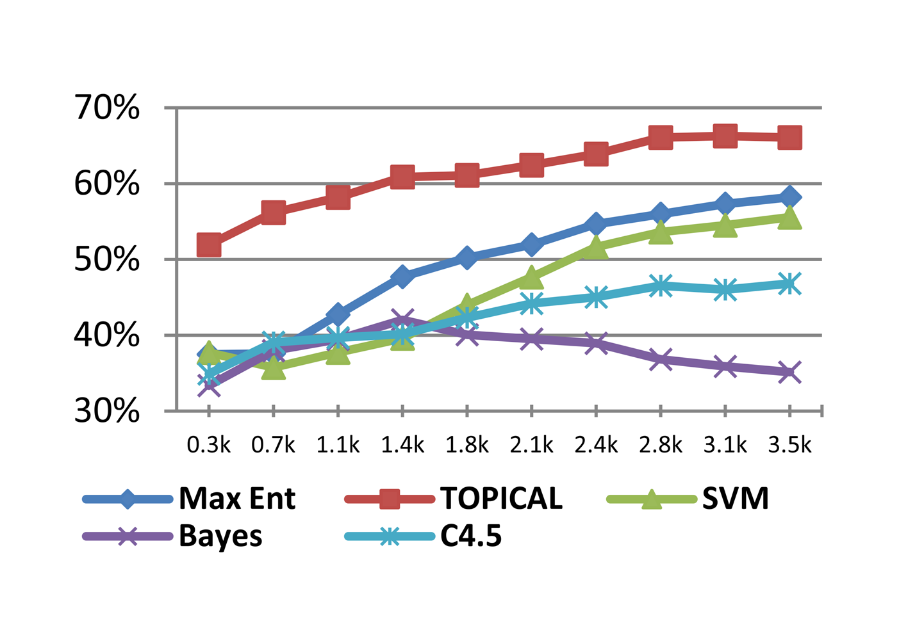
Results [8k tweets]
F1
Training
Size
(tot = 7k)
TAGME

Slide 53
Classification: Concluding remarks
Effective resolution of poly/synonymy issues
Higher performances with small training-set
Robustness wrt a window of time for news

Slide 54

Paper at
ECIR 2012

Slide 55
User profiling

Slide 56
User profiling in Twitter
Parse all tweets of a users via TAGME and via the Stanford NLP Parser, then assign a weight to each detected entity according to its grammatical role in the tweet.
User profile = weighted set of entities
Few interesting advantages:
Small footprint of the user profile, better space and time
Robustness against polysemy and synonymy
Same profile structure for users and tweets

Slide 57
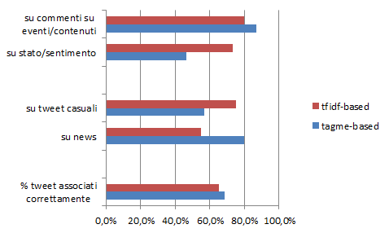
Best user per tweet
[M. Pennacchiotti et al., CIKM 2012]
Problem: Given a tweet predict the “most interested” user
Data = 250 users over 182'000 tweets
  Tested: Classic tf-idf approach versus TagMe-based approach
events/content
status/sentiment
Generic
News
% correct
Our
proposal

Slide 58
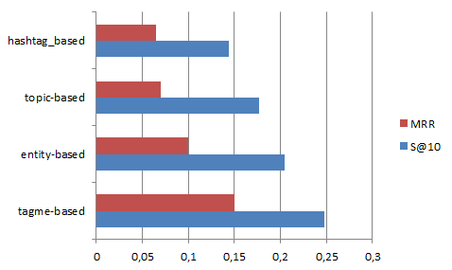
Relevant news per Twitter user
[F. Abel et al., UMAP 2011]
Problem: Given a profiled user, predict interesting news for her
Data = 1619 users over 2 mln tweets.
  3 known approaches versus TagMe-based approach
Reciprocal of the avg pos of first relevant news
Our
proposal
R@10
Prob to have relevant news among top-10

Slide 59
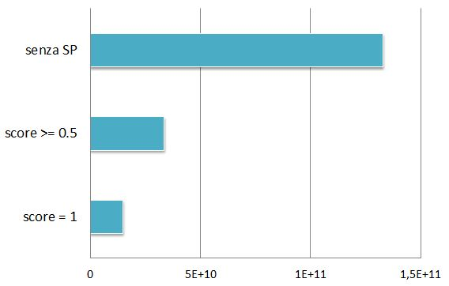
What’s nice: TAGME + SP
R@10 improves slightly
Profile is very compact
Better speed in profile usage
Novel combination of annotator and NLP
No use of Stanford Parser
# topic comparisons

Slide 60
Serendipity in Web search

Slide 61
Anticipating information needs
PROBLEM: Given the current web page p that a user is visiting, we want to recommend a small and diverse set of search queries that are relevant to the content of p, non-obvious and serendipitous.
Not a ‘reverse search’ problem;
Not a standard query recommendation problem;
Needs to be applicable to previously unseen pages.

Slide 62

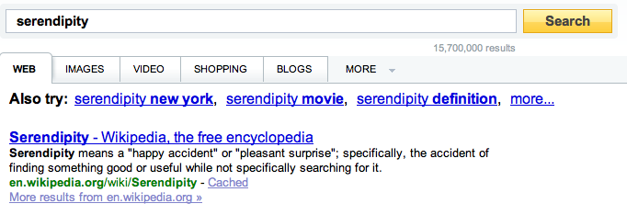
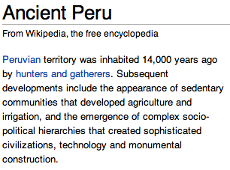
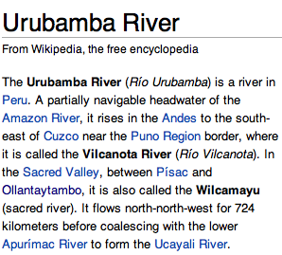


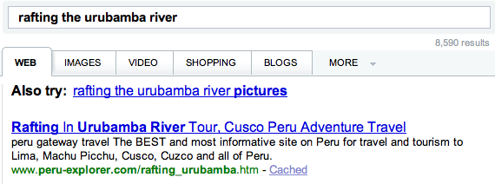
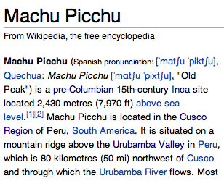
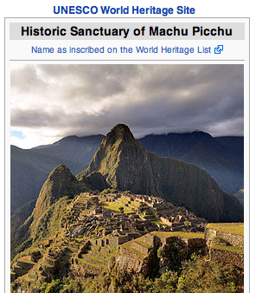
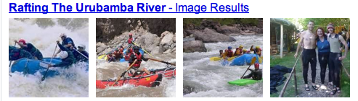
Serendipity in Web Search

Slide 63
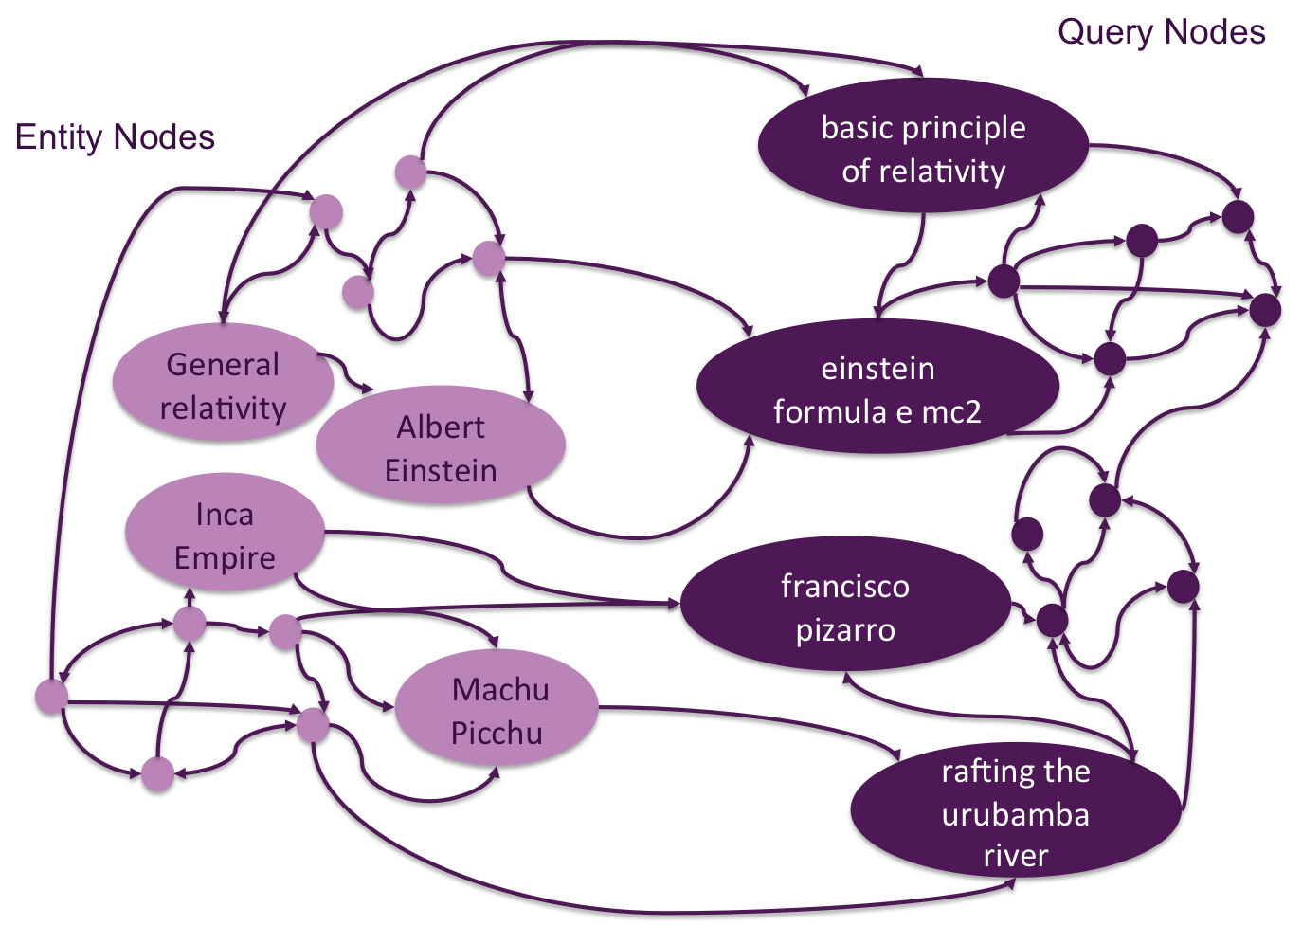

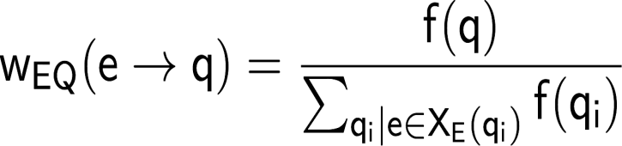
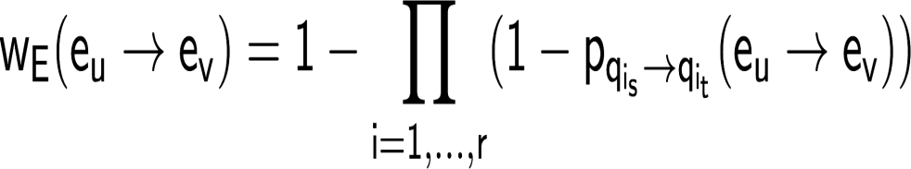
The Entity-Query (EQ) Graph
A large query-log is available
Three types of arcs:
1. query to query:
2. entity to query
3. entity to entity
Query-flow graph
Query nodes
Bordino et al, WSDM 2013

Slide 64
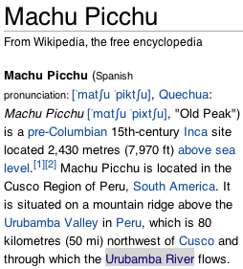
Query recommender for a web page
Machu_Picchu
Pre-Columbian Era
Inca_Empire
Cusco_Region
Peru
Mountain
Entity Extraction
ML_approach
but also
TAGME
Machu_Picchu Spanish_Conquest_of_the_Aztec_Empire
Pre-Columbian_era Andes
Inca_Empire Pachacuti
Cusco_Region Inca_Religion
Peru Atahualpa
Mountain Francisco_Pizarro
South_America Ollantaytambo
Seed set expansion
rafting excursion down the urubamba river
el dorado temple of sun
indios quechuas
map of peru
sapa inca
Retrieval of related queries
Bordino et al, WSDM 2013

Slide 65
Other two steps
Expanding the entity seed
Personalized PageRank on the entity-induced subgraph;
Preference Vector: uniform distribution over the entity seed;
Return the top-N entities that achieve the highest scores.
Seed set of the
Visited Page

Slide 66
Other two steps
Obtaining queries for entities
Personalized PageRank on the full EQ graph (pref vector = uniform);
Return the top-K query nodes that achieve the highest scores.
Some Algorithm Engineering
Pruning: store the top probabilities for each entity in the QE-graph;
Bucketing: group probabilities into buckets of exponentially increasing size.
Expanded
entity set

Slide 67
Search result clustering

Slide 68
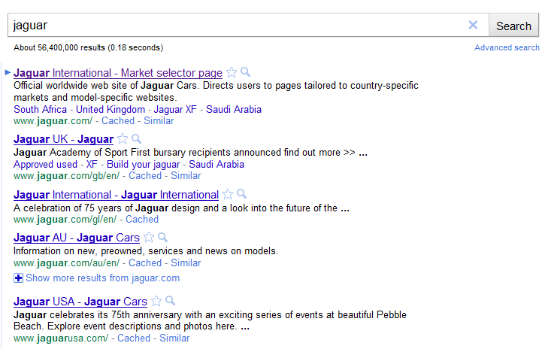

Search Results Clustering
TOPICS
Jaguar Cars
Panthera Onca
Mac OS X
Atari Jaguar
Jacksonville Jags
Fender Jaguar
…

Slide 69
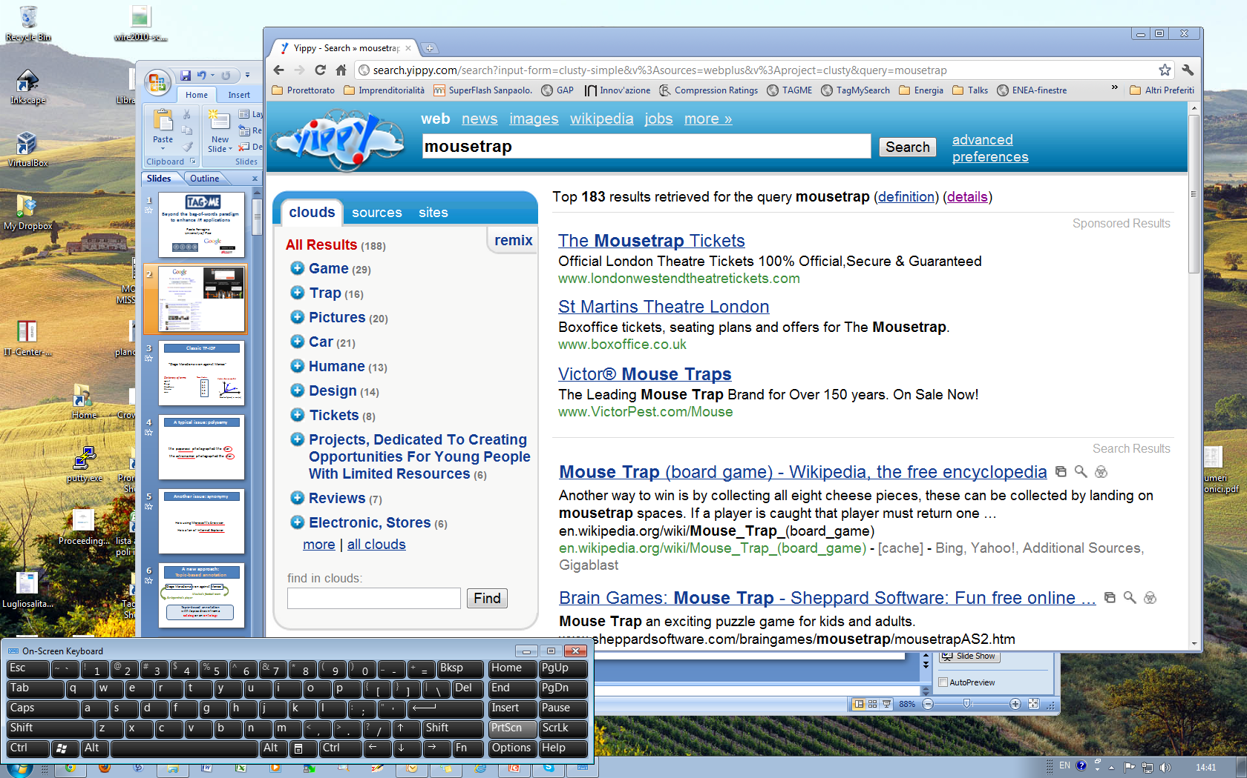

Slide 70

Requirements and issues
Labeled clustering
On-the-fly
Very short and poorly-composed texts
Many polysemy and synonymy issues
Traditonal approaches: bag-of-words & tf-idf
  Vivisimo/Clusty
  Carrot/Lingo
  Snaket [Ferragina-Gullì, WWW ‘05]
products
[Carpineto-Osinski-Romano-Weiss, ACM Comput. Surv. 2009]

Slide 71
Topic-based clustering
Harvest many results from search engine/s
Annotate their snippets via TAGME
Create the graph of snippets and their topics

Slide 72
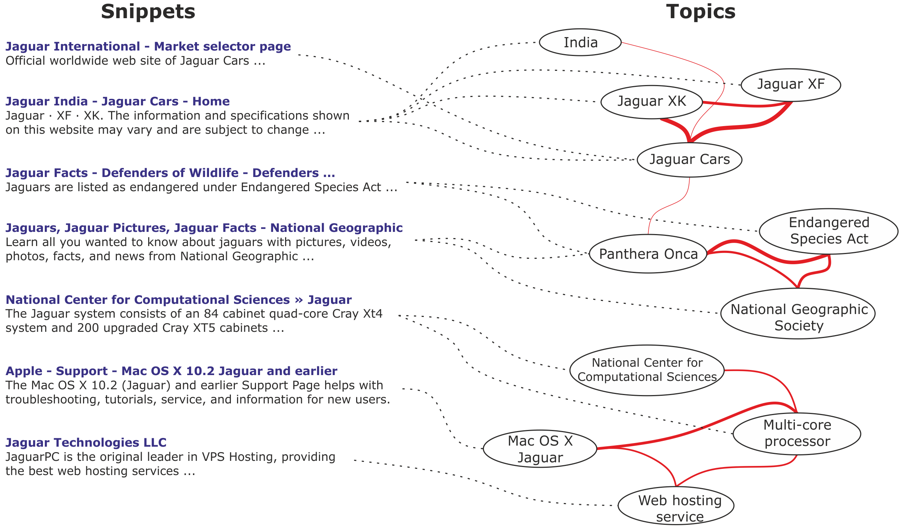

Slide 73
Topic-based clustering
Harvest many results from search engine/s
Annotate their snippets via TAGME
Create the graph of snippets and their topics
Select significant topics via a special set-cover

Slide 74
Best topics selection
TOPICS
SNIPPETS
Set-covering
scan nodes by
sums of ρ of
incident edges
(relevance...)
ρ-score (importance/reliability) assigned by TAGME

Slide 76
Topic-based clustering
Harvest many results from search engine/s
Annotate their snippets via TAGME
Create the graph of snippets and their topics
Select best topics via set-cover
Partition the sub-graph of the best topics
Choose the cluster to cut by its number of covered snippets and sparsity of its subgraph (second eigenvalue)
Use Normalized Laplacian Matrix (Ncut) to bisect the selected partition
Stop as about 10 clusters are created

Slide 77
An example
Normalized Cut

Slide 79
Topic-based clustering
Harvest many results from search engine/s
Annotate their snippets via TAGME
Create the graph of snippets and their topics
Select best topics via set-cover
Partition the sub-graph of the best topics
Derive a clustering of the snippets from topics
Label clusters with titles of their centroid topic
  The one with highest ρ-sum from snippets

Slide 80
c
cv
cv

Slide 81
A comparison
DMOZ: about 300 queries [Carpineto et al, SIGIR 10]
TAGME

Slide 82
Results: kSSL
Subtopic Search Length under k document bound
AMBIENT dataset [Carpineto et al, SIGIR 10]
Many more user studies
We used CrowdFlower
TAGME
K =
A lower value of kSSL is better

Slide 83
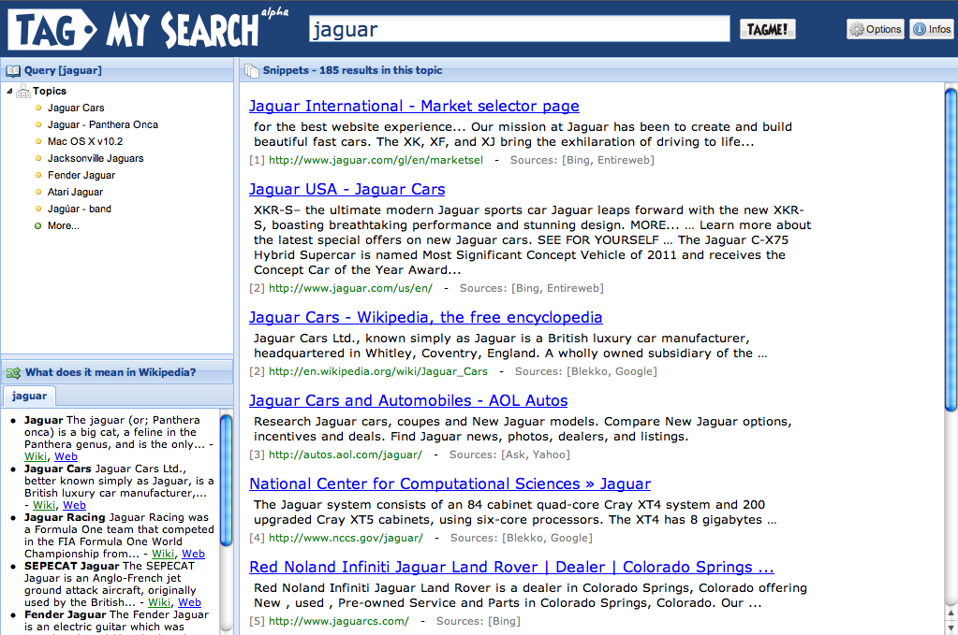
It is slow:
needs AlgoEng
Paper at
ACM WSDM 2012

Slide 84
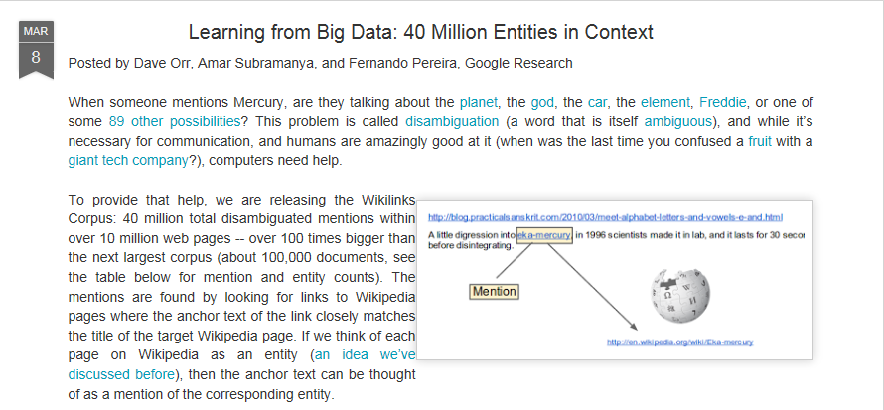
The moral
Topic-based annotators extract useful contextual knowledge
A sort of semantic dimension: Entities can be related within the graph-KB
The better/larger is graph-KB, the more effective is the annotation

Slide 85
The moral
Topic-based annotators extract useful contextual knowledge
A sort of semantic dimension: Entities can be related within the graph-KB
The better/larger is graph-KB, the more effective is the annotation
State-of-the-art tools available
Efficient and effective
Room for improvement, especially on scalability & robustness

Slide 86
Some open problems
Two limitations:
  The Milne-Witten’s formula is simple and efficient but probably not much effective.
  Our voting works for pairs of entities…
How to expand the KB-Wikipedia (not hold on Google’s releases)
The idea of “bipartite graph” with links also in the entity-subgraph is powerful
  New application ideas?

Slide 87
Text Similarity

Slide 88
Explicit Semantic Analysis
T = {w₁…w_{n}} be input text
<tfidf_{i}> be its TFIDF weight of word w_{i}
Wikipedia concept/entity c_{j}
  N = total number of Wikipedia concepts
<k_{ij}> quantifies the strength of association of word w_{i} with Wikipedia concept c_{j}

Slide 89
Explicit Semantic Analysis
[Gabrilovitch et al, IJCAI 07]
the semantic interpretation vector V for text T is a vector of length N, in which
weight(c_{j}) = Sum_{w_{i} ∈ T} w_{i} * c_{ij}
To compute semantic relatedness of a pair of texts we compare their vectors using the cosine metric
Yet vector space model

Slide 90
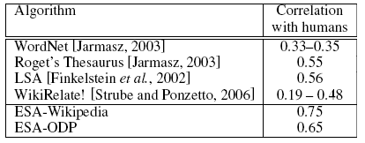
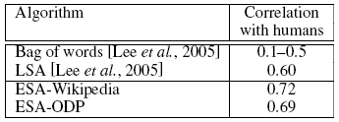
Results
word relatedness
text relatedness

Slide 91
Random walks for Text Sim
Given two texts, we map them to two sets of nodes/entities
  We stick onto the graph representation
Graph-KB of concepts
Text 1
Volumes
of random paths
Text 2

Slide 92
Proximity measures from random walks
Hitting time: Expected time to hit node j starting at node i
  It is not symmetric. h(i,j) > h(j,i) = 1
  h(i,j) = 1 + Σ_{kЄnbs(i)} p(i,k)h(k,j)
Commute time: Expected time to hit j and come back to i
  It is symmetric, c(i,j) = h(i,j) + h(j,i)
Personalized PageRank, with restart vector
Visiting probability (with truncation): probability of visiting j starting from i, with penalization for long paths (deals with self-loops that boost their nodes more than others)
j
i

