Slide 1
A new era:
Topic-based Annotators

Slide 2
Classical approach
“Diego Maradona won against Mexico”
Dictionary of terms
against
Diego
Maradona
Mexico
won
Term Vector
Vector Space model
2.2
5.1
9.1
1.0
0.1
t₃
v
α
w
t₂
t₁
Similarity(v,w) ≈ cos(α)
Mainly term-based:
polysemy and synonymy issues

Slide 3
Another issue: synonymy
He is using Microsoft’s browser
He is a fan of Internet Explorer

Slide 4
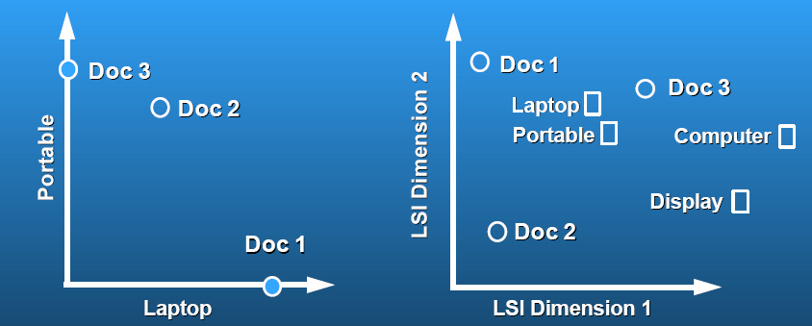
Latent Semantic Analysis
Sec. 18.4
Related terms get projected to the same concept dimension
Polysemy is not yet solved, concepts are latent
courtesy of Susan Dumais

Slide 5
A typical issue: polysemy
the paparazzi photographed the star
the astronomer photographed the star

Slide 6
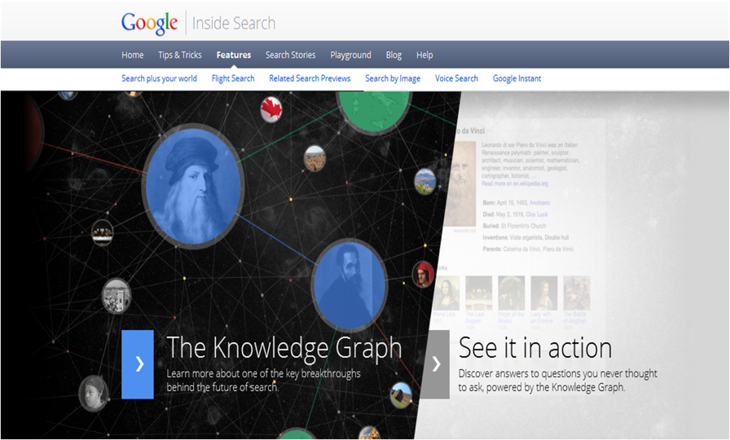
A new approach:
Massive graphs of entities and relations
May 2012
6

Slide 7
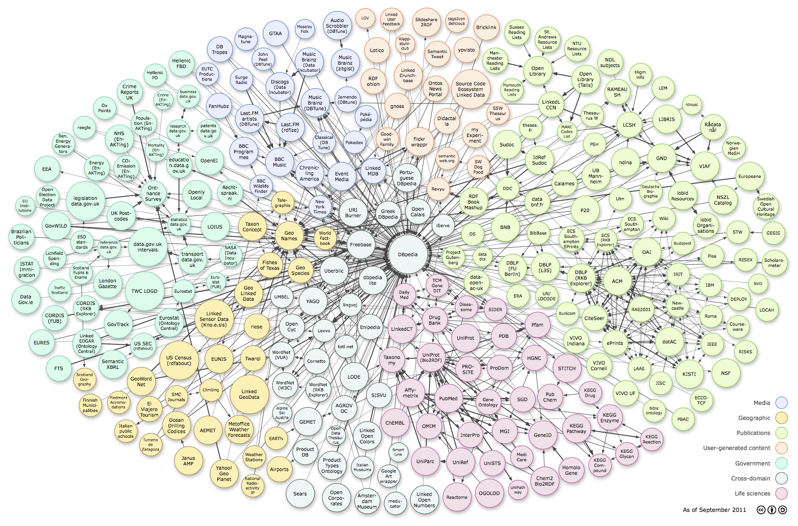













Web of Data: RDF, Tables, Microdata
Cyc
7
http://richard.cyganiak.de/2007/10/lod/lod-datasets_2011-09-19_colored.png
Thanks to G. Weikum, SIGMOD 2013

Slide 8

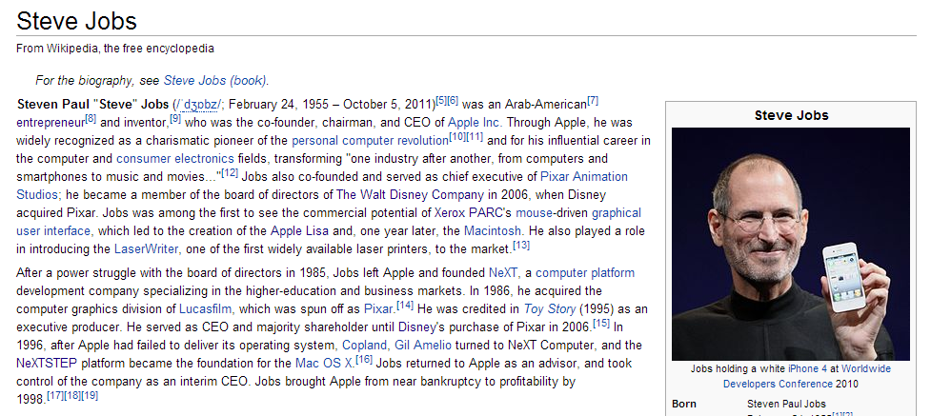

Wikipedia is a rich source of instances

Slide 9
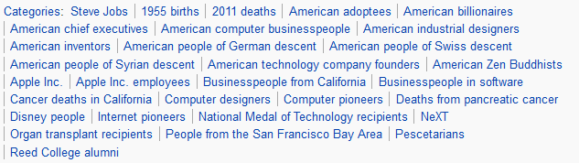
Wikipedia's categories contain classes
Categories form a taxonomic DAG (not really…)

Slide 10
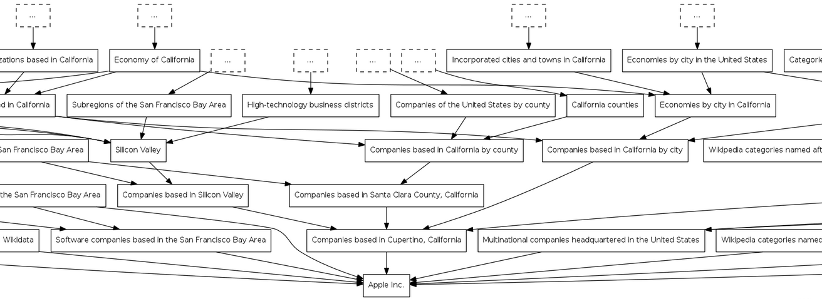
DAG of categories: http://toolserver.org/~dapete/catgraph/
10

Slide 11
A new approach:
Topic-based annotation
“Diego Maradona won against Mexico”
Mexico’s football team
Ex-Argentina’s player
anchors
Find mentions and annotate them
with topics drawn from a catalog
articles
Wikipedia!

Slide 12

Polysemy
Celebrity is a person who is famou-sly recognized …
the paparazzi photographed the star
the astronomer photographed the star
Star is a massive, luminous ball of plasma …

Slide 13
Synonymy
Internet Explorer (IE o MSIE), oggi noto anche con il nome Windows Internet Explorer (WIE), è un browser web grafico proprietario sviluppato da Microsoft …
He is using Microsoft’s browser
She plays with Internet Explorer

Slide 14
Why is it a difficult problem?
“Diego Maradona won against Mexico”
Ex-Argentina’s coach
His nephew
Maradona Stadium
Maradona Movie
…
Mexico nation
Mexico state
Mexico football team
Mexico baseball team
…
Don’t annotate!

Slide 15
Features used to link a → p
Commonness of a page
p wrt an anchor a
Context of a around the mention
T = …w₁ w₂ w₃ a w₄ w₅ w₆ …
and the content of a page/entity
Page p = z₁ z₂ z₃ z₄ z₅ z₆ …
Link probability of an anchor a
Graph-based features
a is a mention-node
p is an entity-node
Links a ◻ p and paths between pages

Slide 16
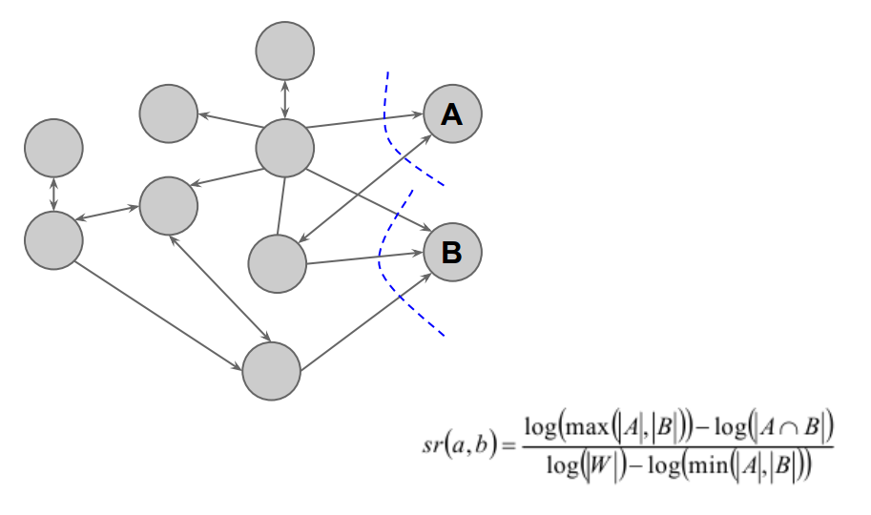
Relatedness between pages

Slide 17
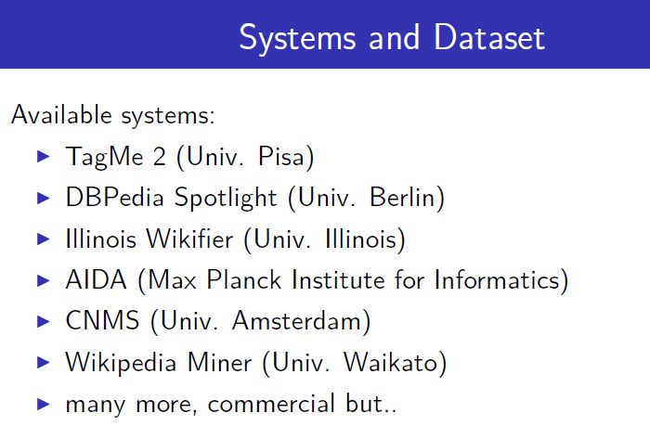
The literature
Many commercial software: AlchemyAPI, DBpedia Spotlight, Extractiv, Lupedia, OpenCalais, Saplo, SemiTags, TextRazor, Wikimeta, Yahoo! Content Analysis, Zemanta.

Slide 18


[Ferragina-Scaiella, CIKM 2010]
tagme.di.unipi.it
Designed for short texts
  news, blogs, search-results snippets, tweets, ads, etc
  competitive on long texts too
Achieves high accuracy
  Massive experimental test on millions of short texts
Fast
  More than 10x faster than others
  100% Java

Slide 19
How TAGME works
“Diego Maradona won against Mexico”
Diego A. Maradona
Diego Maradona jr.
Maradona Stadium
Maradona Film
…
…
Mexico nation
Mexico state
Mexico football team
Mexico baseball team
…
…
No Annotation
DISAMBIGUATION
by a voting scheme
PRUNING
2 simple features
PARSING

Slide 20
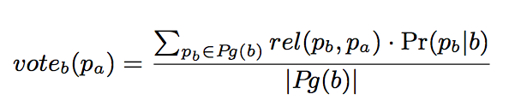
Disambiguation: The voting scheme
Collective agreement among topics via voting
“Diego Maradona won against Mexico”
b
a
p_{b}
Diego A. Maradona
Diego Maradona jr.
Maradona Stadium
Maradona Film
…
Wiki-articles | Votes
Mexico | 0.09
State of Mexico | 0
Mexico National Football Team | 0.29
Mexico National Baseball Team | 0
p_{a}

Slide 21
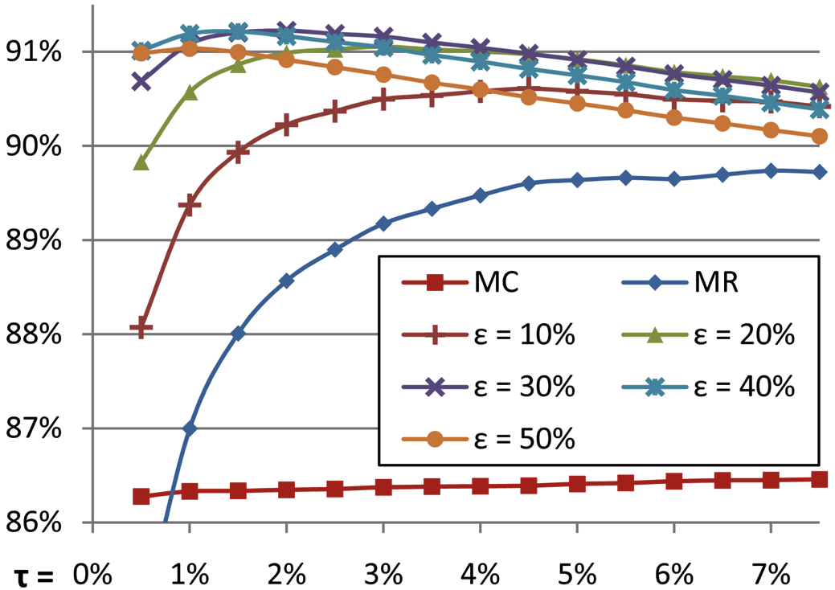
Disambiguation: all steps
τ = trade-off
speed vs. recall
Commonness of a page
p wrt an anchor a
Pruning by commonness < τ
Voting scheme
Select top-ε pages
Select the best in commonness

Slide 22
Pruning
We use 2 features:
  link probability
  coherence wrt context
Compute a ρ score via
  3 classifiers, avg, linear combination
  if ρ < ρ_{NA} then prune!
Link probability of an anchor a
Avg. relatedness btw the assigned concept to the others
balance
precision vs. recall

Slide 23
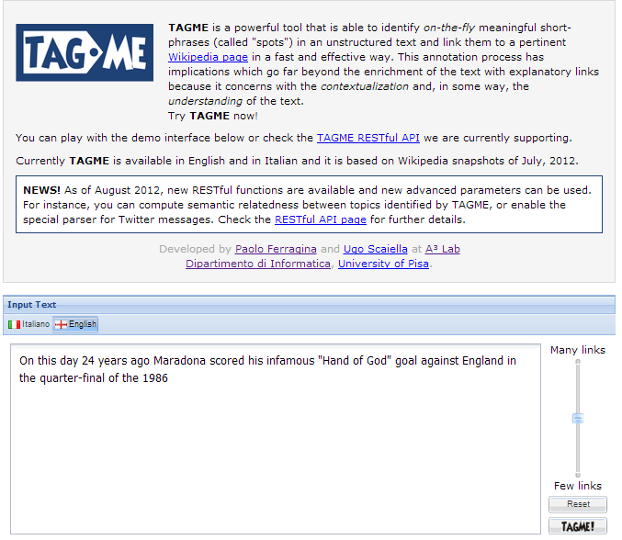

Slide 24
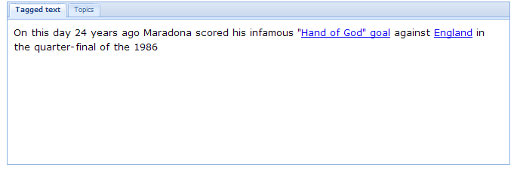
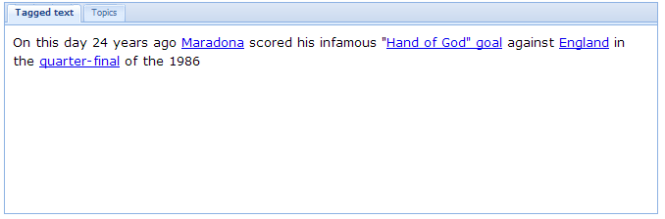
Less links
More links

Slide 25
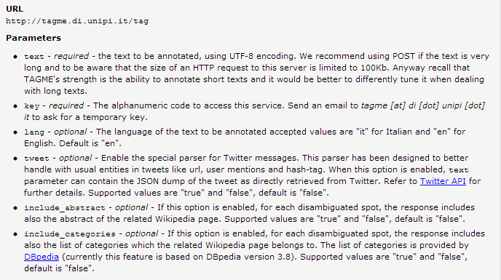
Tagging → Json

Slide 26
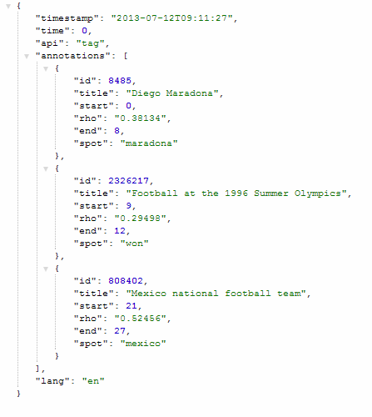
http://tagme.di.unipi.it/tag?key=Cosenza2015&text=maradona%20won%20against%20mexico
Useful for relating topics
NLP ?
Cosenza2015

Slide 27
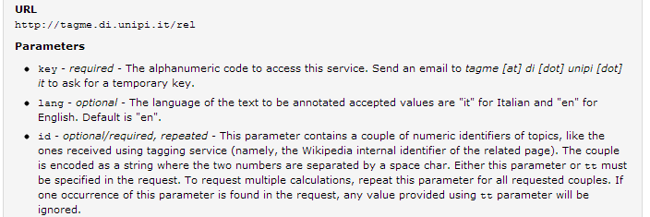
Relating topics
http://en.wikipedia.org/w/api.php?action=query&titles=Roberto%20Baggio
http://en.wikipedia.org/w/api.php?action=query&pageids=8485
http://tagme.di.unipi.it/rel?key=Cosenza2015&id=8485 25624
Maradona vs Baggio
0,8157

Slide 28
Dense Subgraph
Mentions = Anchor Texts
Entities = Wikipedia Pages
50
30
50
20
30
10
10
90
100
30
80
20
90
100
90
5
30
Compute dense subgraph such that:
each mention is connected to at most one entity
28
Thanks to G. Weikum, SIGMOD 2013

Slide 29
Random Walks
ε
0.5
50
ε
0.83
0.3
50
30
0.2
20
0.23
ε
0.1
0.17
30
10
10
0.7
90
0.77
100
0.25
30
0.2
ε
0.4
20
0.75
80
90
0.75
0.96
90
100
ε
0.15
0.04
30
5
ε
for each mention run personalized PageRank with restart
rank entity e by stationary visiting probability, starting from m
29
Thanks to G. Weikum, SIGMOD 2013

Slide 30
On comparing annotators

Slide 31
A new approach:
Topic-based annotation
“Diego Maradona won against Mexico”
Mexico’s football team
Ex-Argentina’s player
anchors
Find mentions and annotate them
with topics drawn from a catalog
articles
Wikipedia!

Slide 32
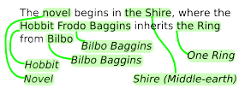

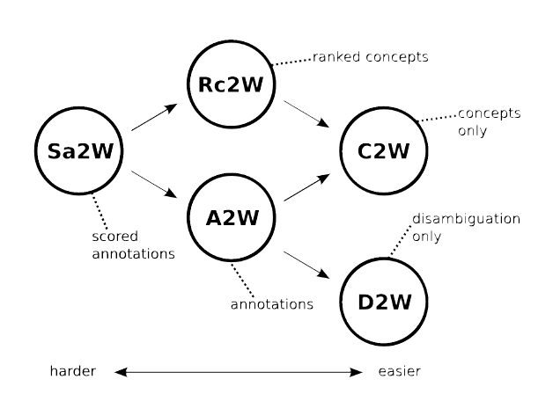
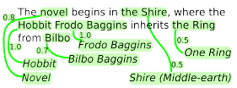
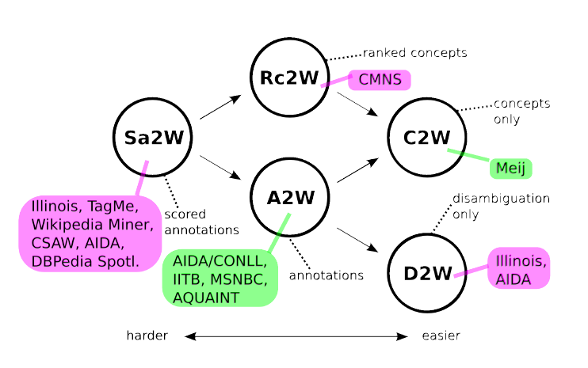

A word of caution !
A2W
Sa2W
Rc2W

Slide 33
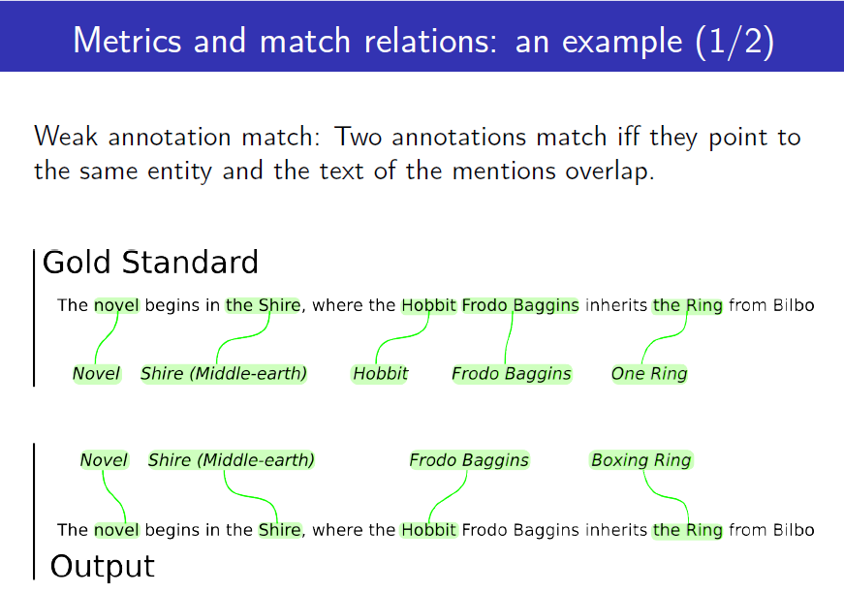

Slide 34
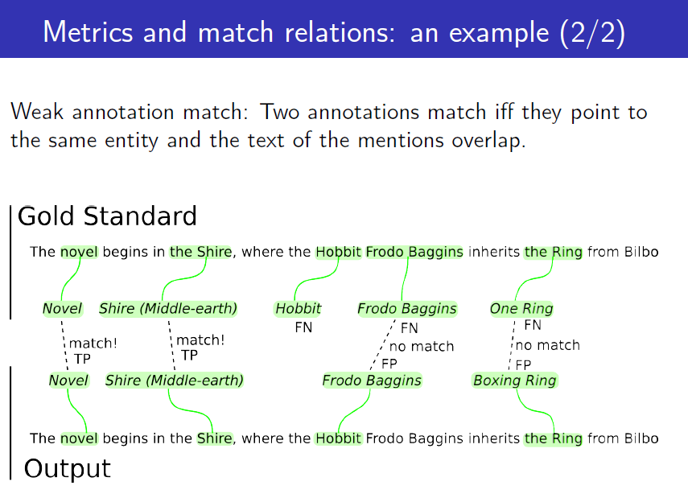

Slide 35
Is it just a matter of “annotation” ?

Slide 36
#1: Classic BOW-representation
t₃
cos(α) = v • w / ||v|| * ||w||
T₂
α
T₁
T₅
t₁
t₂
T is an input text
D is the dictionary of the terms in the collection
Represent T via a vector consisting of |D| components

Slide 37
#2: LSI-representation
You still use cos-similarity for doc comparison
Docs live in a reduced-space of latent concepts
  LSI projects m-dim space → k-dim space
  Compare docs/queries in latent space
k
=
Reduced doc
d
R^{T}
k
k x m
m

Slide 38
#3: Vector space expansion
T is an input text
D is the dictionary of m terms in the collection
Represent T via a vector consisting of m + k components (syntactic and latent)
Use cos-similarity among expanded vectors

Slide 39
#4: Other vector expansion
T is an input text
D is the dictionary of m terms in the collection
Represent T via a vector consisting of
m + #Wikipedia-pages components
Terms are weighted via e.g. tf-idf
How do you weight the Wikipedia pages ?
You could use the rho-score assigned by TagME

Slide 40
#5: Explicit Semantic Analysis
[Gabrilovitch et al, IJCAI 07]
Given T be an input text,
  The weight for text T of the component referring to term t_{i}
  Repr[T,t_{i}] = Tf-Idf_{i,T}
  The weight for text T of the component referring to the Wikipedia page P_{j}
  Repr[T,P_{j}] = <Repr[T], Repr[P_{j}]>

Slide 41
#5: Explicit Semantic Analysis
[Gabrilovitch et al, IJCAI 07]
To compute semantic relatedness of a pair of texts, compute the cosine similarity of their ESA vectors, consisting of n + |Wikipedia| components
Yet vector space model, thus it does not take into account for the similarity of P_{j} versus P_{h}

Slide 42
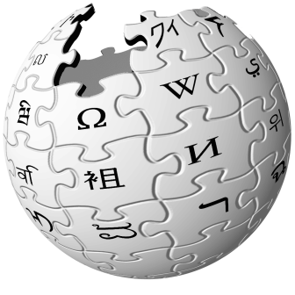
#6: graph of concepts
obama says gaddafi may way out military assault
Barack Obama
Muammar
al-Gaddafi
Offensive
(military)
President of the
United States
Libya
Ultimatum
us president issues libya ultimatum

Slide 43

Text as a sub-graph of topics
Barack Obama
President of the United States
Mahmoud Ahmadinejad
Iran
Ultimatum
RQ-170 drone
Any relatedness measure over a graph, e.g. [Milne & Witten, 2008]

Slide 44
Random walks for Text Sim
Given two texts, we map them to two sets of nodes/entities
  We stick onto the graph representation
Graph-KB of concepts
Text 1
Volumes
of random paths
in the concept
graph (e.g. Wikipedia)
Text 2
Latest approaches combine: category hierarchy, Wikipedia graph, random walks, Word2Vect representation of terms & entities,….

Slide 45
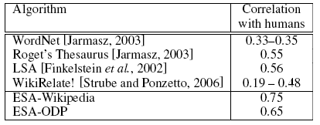
Results
word relatedness
text relatedness

Slide 46
Some applications of this novel text representation

Slide 47
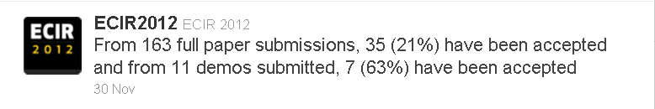
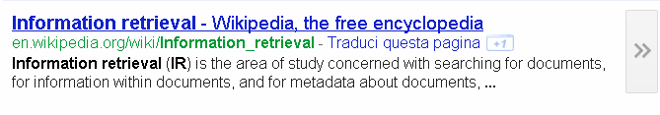
Text Categorization
It is the problem of labeling natural language texts with one or more thematic categories drawn from a predefined set.
Many solutions for long texts (hence many terms)
  Naive Bayes, SVM, k-NN, MaxEnt, Decision Tree…
few for short texts
which are poorly
composed

Slide 48
Topical classification of news
Training (given a set of classes)
Annotate the training-set using TAGME
For each class z, create a subset of Wikipedia pages (topics) T_{z} by importance and distinctiveness
Test
Annotate the text to be classified using TAGME
Classify the text by computing the ρ−weighted relatedness between any text’s topic with the subset of topics T_{z} assigned to each category z (ρ of topic in text).

Slide 49
Example
SPORT
SCI-TECH
BUSINESS
HEALTH
....
Rafael Nadal
World Wide Web
Eurozone
Patient
Coach (sport)
NASA
Stock
Infants
NBA Playoffs
web search engine
Federal Reserve
Cholesterol
Roger Federer
Planet
Wall Street
HIV
…
…
…
…
Francesca Schiavone won Roland Garros
SPORT
Francesca Schiavone
French Open
Relatedness measure

Slide 50
Some experiments
Categories
Sport
Business
U.S.
Health
Sci&Tech
World
Entertainment
32K items from 3 RSS news-feeds

Slide 51
User profiling

Slide 52
User profiling in Twitter
Parse all tweets of a users via TAGME and via the Stanford NLP Parser, then assign a weight to each detected entity according to its grammatical role in the tweet.
User profile = weighted set of entities
Few interesting advantages:
Small footprint of the user profile, better space and time
Robustness against polysemy and synonymy
Same profile structure for users and tweets

Slide 53
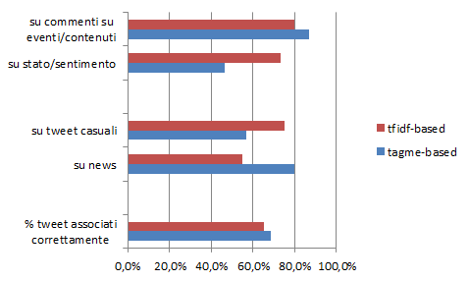
Best user per tweet
[M. Pennacchiotti et al., CIKM 2012]
Problem: Given a tweet predict the “most interested” user
Data = 250 users over 182'000 tweets
  Tested: Classic tf-idf approach versus TagMe-based approach
events/content
status/sentiment
Generic
News
% correct

