Slide 1
Prefix Codes
A prefix code is a variable length code in which no codeword is a prefix of another one
e.g a = 0, b = 100, c = 101, d = 11
Can be viewed as a binary trie
0
1
0
1
a
0
1
d
b
c

Slide 2
Data Compression
Integers compression

Slide 3
From text to integer compression
T = ab b a ab c, ab b b c abc a a, b b ab.
Encode : 3121431561312121517141461212138
Terms | Num. occurrences | Rank
space | 14 | 1
b | 5 | 2
ab | 4 | 3
a | 3 | 4
c | 2 | 5
, | 2 | 6
abc | 1 | 7
. | 1 | 8
Compress terms by
encoding their ranks
with var-len encodings
Golden rule of
data compression
holds: frequent
words get small
integers and thus
will be encoded
with fewer bits

Slide 4
γ−code for integer encoding
Length-1
x > 0 and Length = ⎣log₂ x⎦ +1
e.g., 9 represented as <000,1001>.
γ−code for x takes 2 ⎣log₂ x⎦ +1 bits
(ie. factor of 2 from optimal)
  Optimal for Pr(x) = 1/2x², and i.i.d integers

Slide 5
It is a prefix-free encoding…
Given the following sequence of γ−coded integers, reconstruct the original sequence:
0001000001100110000011101100111
8
6
3
59
7

Slide 6
δ−code for integer encoding
Use γ-coding to reduce the length of the first field
Useful for medium-sized integers
e.g., 19 represented as <00,101,10011>.
δ−coding x takes about
⎣log₂ x⎦ + 2 ⎣log₂( ⎣log₂ x⎦ +1)⎦ + 2 bits.
  Optimal for Pr(x) = 1/2x(log x)², and i.i.d integers

Slide 7
Rice code (simplification of Golomb code)
[q times 0s] 1
Log k bits
It is a parametric code: depends on k
Quotient q=⎣(v-1)/k⎦, and the rest is r= v – k * q – 1
Useful when integers concentrated around k
How do we choose k ?
  Usually k ≈ 0.69 * mean(v) [Bernoulli model]
  Optimal for Pr(v) = p (1-p)^{v-1}, where mean(v)=1/p, and i.i.d ints

Slide 8
Variable-byte codes
Wish to get very fast (de)compress → byte-align
e.g., v=2¹⁴+1 → binary(v) = 100000000000001
1 0000000 0000001
Note: We waste 1 bit per byte, and avg 4 for the first byte.
We know where to stop, before reading next codeword.
0000001 0000000 0000001
10000001 10000000 00000001

Slide 9
(s,c)-dense codes
A new concept, good for skewed distr
: Continuers vs Stoppers
  Variable-byte is using: s = c = 128
It is a prefix-code
The main idea is:
  s + c = 256 (we are playing with 8 bits)
  Thus s items are encoded with 1 byte
  And s*c with 2 bytes, s * c² on 3 bytes, s * c³ on 4 bytes...
An example
  5000 distinct words
  Var-byte encodes 128 + 128² = 16512 words on 2 bytes
  (230,26)-dense code encodes 230 + 230*26 = 6210 on 2 bytes, hence more on 1 byte and thus better on skewed...
Notes:
Normal huffman codes are static.
To be applied in a dynamic model, we need a

Slide 10
PForDelta coding
Use b (e.g. 2) bits to encode 128 numbers or create exceptions
3
42
2
3
3
1
1
…
3
3
23
1
2
11
10
11
11
01
01
…
11
11
01
10
42
23
a block of 128 numbers
Translate data: [base, base + 2^{b}-1] → [0,2^{b}-1]
Encode exceptions: ESC or pointers
Choose b to encode 90% values, or trade-off:
b↑ waste more bits, b↓ more exceptions
Notes:
Normal huffman codes are static.
To be applied in a dynamic model, we need a

Slide 11
Advanced Algorithms for Massive DataSets
Data Compression

Slide 12
Huffman Codes
Invented by Huffman as a class assignment in ‘50.
Used in most compression algorithms
  gzip, bzip, jpeg (as option), fax compression,…
Properties:
  Generates optimal prefix codes
  Fast to encode and decode

Slide 13
Running Example
p(a) = .1, p(b) = .2, p(c ) = .2, p(d) = .5
a(.1)
b(.2)
c(.2)
d(.5)
0
1
1
(.3)
1
0
(.5)
0
(1)
a=000, b=001, c=01, d=1
There are 2^{n-1} “equivalent” Huffman trees

Slide 14
Entropy (Shannon, 1948)
For a source S emitting symbols with probability p(s), the self information of s is:
bits
Lower probability → higher information
Entropy is the weighted average of i(s)
i(s)
0-th order empirical entropy of string T

Slide 15
Performance: Compression ratio
Compression ratio =
#bits in output / #bits in input
Compression performance: We relate entropy against compression ratio.
Empirical H vs Compression ratio
Shannon
Avg cw length
In practice
p(A) = .7, p(B) = p(C) = p(D) = .1
H ≈ 1.36 bits
Huffman ≈ 1.5 bits per symb

Slide 16
Problem with Huffman Coding
We can prove that (n=|T|):
n H(T) ≤ |Huff(T)| < n H(T) + n
which looses < 1 bit per symbol on avg!!
This loss is good/bad depending on H(T)
  Take a two symbol alphabet Σ = {a,b}.
  Whichever is their probability, Huffman uses 1 bit for each symbol and thus takes n bits to encode T
  If p(a) = .999, self-information is:
  bits << 1
Notes:
It might seem like we cannot do better than this.
Assuming Huffman codes, how could we improve this?
Assuming there is only one possible other message (with prob. .001), what would the
Expected length be for sending 1000 messages picked from this distribution? (about 10bits + 1.44 bits = 11.44 bits)

Slide 17
Huffman’s optimality
Average length of a code = Average depth of its binary trie
Reduced tree = tree on (k-1) symbols
  substitute symbols x,z with the special “x+z”
T
RedT
d
d
+1
+1
“x+z”
x
z
L_{RedT} = …. + d *(p_{x} + p_{z})
L_{T} = …. + (d+1)*p_{x} + (d+1)*p_{z}
L_{T} = L_{RedT} + (p_{x} + p_{z})

Slide 18
Huffman’s optimality
Clearly Huffman is optimal for k=1,2 symbols
By induction: assume that Huffman is optimal for k-1 symbols, hence
L_{RedH} (p₁, …, p_{k-2}, p_{k-1} + p_{k} ) is minimum
Now, take k symbols, where p₁ ≥ p₂ ≥ p₃ ≥ … p_{k-1} ≥ p_{k}
Clearly L_{opt} (p₁, …, p_{k-1} , p_{k} ) = L_{RedOpt} (p₁, …, p_{k-2}, p_{k-1} + p_{k} ) + (p_{k-1} + p_{k})
optimal on k-1 symbols (by induction), here they are (p₁, …, p_{k-2}, p_{k-1} + p_{k} )
L_{Opt} = L_{RedOpt} [p₁, …, p_{k-2}, p_{k-1} + p_{k} ] + (p_{k-1} + p_{k})
≥ L_{RedH} [p₁, …, p_{k-2}, p_{k-1} + p_{k} ] + (p_{k-1} + p_{k})
= L_{H}

Slide 19
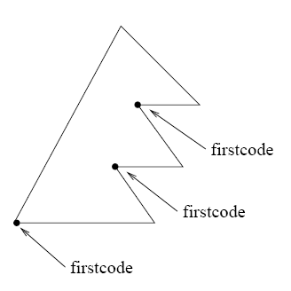
Model size may be large
Huffman codes can be made succinct in the representation of the codeword tree, and fast in (de)coding.
Canonical Huffman tree
We store for any level L:
firstcode[L]
Symbols[L], for each level L
= 00.....0
Notes:
Normal huffman codes are static.
To be applied in a dynamic model, we need a

Slide 20
Canonical Huffman
(.4)
(.1)
(.6)
(.04)
(.02)
(.02)
1(.3)
2(.01)
3(.01)
4(.06)
5(.3)
6(.01)
7(.01)
1(.3)
2 5 5 3 2 5 5 2

Slide 21
Canonical Huffman: Main idea..
Symb Level
1 2
2 5
3 5
4 3
5 2
6 5
7 5
8 2
We want a tree with this form
WHY ??
1 5 8
4
2 3 6 7
It can be stored succinctly using two arrays:
firstcode[]= [--,01,001,--, 00000] = [--,1,1,--, 0] (as values)
Symbols[][]= [ [], [1,5,8], [4], [], [2,3,6,7] ]

Slide 22
Canonical Huffman: Main idea..
Symb Level
1 2
2 5
3 5
4 3
5 2
6 5
7 5
8 2
How do we compute FirstCode
without building the tree ?
1 5 8
4
sort
2 3 6 7
numElem[] = [0, 3, 1, 0, 4]
Symbols[][]= [ [], [1,5,8], [4], [], [2,3,6,7] ]
Firstcode[5] = 0
Firstcode[4] = ( Firstcode[5] + numElem[5] ) / 2 = (0+4)/2
= 2 (= 0010 since it is on 4 bits)

Slide 23
Some comments
Symb Level
1 2
2 5
3 5
4 3
5 2
6 5
7 5
8 2
Value 2
1 5 8
4
Value 2
sort
2 3 6 7
numElem[] = [0, 3, 1, 0, 4]
Symbols[][]= [ [], [1,5,8], [4], [], [2,3,6,7] ]
firstcode[]= [2, 1, 1, 2, 0]

Slide 24

Canonical Huffman: Decoding
Value 2
1 5 8
Succint and fast in decoding
4
Firstcode[]= [2, 1, 1, 2, 0]
Symbols[][]= [ [], [1,5,8], [4], [], [2,3,6,7] ]
Value 2
2 3 6 7
T=...00010...
Decoding procedure
Symbols[5][2-0]=6

Slide 25
Can we improve Huffman ?
Macro-symbol = block of k symbols
  1 extra bit per macro-symbol = 1/k extra-bits per symbol
  Larger model to be transmitted: |Σ|^{k} (k * log |Σ|) + h² bits (where h might be |Σ|)
Shannon took infinite sequences, and k → ∞ !!
Notes:
It might seem like we cannot do better than this.
Assuming Huffman codes, how could we improve this?
Assuming there is only one possible other message (with prob. .001), what would the
Expected length be for sending 1000 messages picked from this distribution? (about 10bits + 1.44 bits = 11.44 bits)

Slide 26
Data Compression
Arithmetic coding

Slide 27
Introduction
Allows using “fractional” parts of bits!!
Takes 2 + nH₀ bits vs. (n + nH₀) of Huffman
Used in PPM, JPEG/MPEG (as option), Bzip
More time costly than Huffman, but integer implementation is not too bad.

Slide 28
Symbol interval
Assign each symbol to an interval range from 0 (inclusive) to 1 (exclusive).
e.g.
1.0
c = .3
0.7
b = .5
f(a) = .0, f(b) = .2, f(c) = .7
0.2
a = .2
0.0
The interval for a particular symbol will be called
the symbol interval (e.g for b it is [.2,.7))
Notes:
We are going to make a distinction between message, sequence, and code intervals.
It is important to keep them straight.
Also I will give different meanings to p(I) and p_{i} and it is important to keep these straight

Slide 29
Sequence interval
Coding the message sequence: bac
The final sequence interval is [.27,.3)
1.0
0.7
0.3
c = .3
c = .3
(0.7-0.2)*0.3=0.15
(0.3-0.2)*0.3=0.03
c = .3
0.7
0.55
0.27
b = .5
b = .5
(0.7-0.2)*0.5 = 0.25
b = .5
(0.3-0.2)*0.5 = 0.05
0.2
0.3
0.22
a = .2
a = .2
(0.7-0.2)*0.2=0.1
(0.3-0.2)*0.2=0.02
a = .2
0.0
0.2
0.2
Notes:
If the notation gets confusing, the intuition is still clear, as shown by this example.

Slide 30
The algorithm
To code a sequence of symbols with probabilities
p_{i} (i = 1..n) use the following algorithm:
Each message narrows the interval by a factor of p_{i}.
0.3
c = .3
0.27
b = .5
0.22
a = .2
0.2
Notes:
How does the interval size relate to the probability of that message sequence?

Slide 31
The algorithm
Each message narrows the interval by a factor of p[T_{i}]
Final interval size is
Sequence interval
[ l_{n} , l_{n} + s_{n} ]
A number inside
Notes:
How does the interval size relate to the probability of that message sequence?

Slide 32
Decoding Example
Decoding the number .49, knowing the message is of length 3:
The message is bbc.
1.0
0.7
0.55
c = .3
c = .3
c = .3
0.49
0.7
0.55
0.475
0.49
0.49
b = .5
b = .5
b = .5
0.2
0.3
0.35
a = .2
a = .2
a = .2
0.0
0.2
0.3
Notes:
Basically we are running the coding example but instead of paying attention to the symbol names,
We pay attention to the number.

Slide 33
How do we encode that number?
If x = v/2^{k} (dyadic fraction) then the encoding is equal to bin(x) over k digits (possibly pad with 0s in front)
Notes:
It is not a prefix code.

Slide 34
How do we encode that number?
Binary fractional representation:
FractionalEncode(x)
x = 2 * x
If x < 1 output 0
x = x - 1; output 1
2 * (1/3) = 2/3 < 1, output 0
2 * (2/3) = 4/3 > 1, output 1
→ 4/3 – 1 = 1/3
Incremental Generation
Notes:
It is not a prefix code.

Slide 35
Which number do we encode?
Truncate the encoding to the first d = ⎡log (2/s_{n})⎤ bits
Truncation gets a smaller number… how much smaller?
l_{n} + s_{n}
l_{n} + s_{n}/2
Compression = Truncation
l_{n}
=0
Notes:
It is not a prefix code.

Slide 36
Bound on code length
Theorem: For a text of length n, the Arithmetic encoder generates at most
⎡log₂ (2/s_{n})⎤ < 1 + log₂ 2/s_{n} = 1 + (1 - log₂ s_{n})
= 2 - log₂ (∏ _{i=1,n} p(T_{i}))
= 2 - ∑ _{i=1,n} (log₂ p(T_{i}))
= 2 - ∑_{σ=1,|Σ|} n*p(σ) log p(σ)
= 2 + n * ∑_{σ=1,|Σ|} p(σ) log (1/p(σ))
= 2 + n H(T) bits
T = aaba
s_{n} = p(a) * p(a) * p(b) * p(a)
log₂ s_{n} = 3 * log p(a) + 1 * log p(b)
nH₀ + 0.02 n bits in practice
because of rounding
Notes:
The 1 + log s is from previous slide based on truncating to -log(s/2) bits.
Note that s is overloaded (size of sequence interval, and self information of message). I apologize.

Slide 37
Data Compression
Dictionary-based compressors

Slide 38
LZ77
Algorithm’s step:
  Output <dist, len, next-char>
  Advance by len + 1
A buffer “window” has fixed length and moves
a
a
c
a
a
c
a
b
c
a
a
a
a
a
a
a
c
Dictionary
(all substrings starting here)
<6,3,a>
a
a
c
a
a
c
a
b
c
a
a
a
a
a
a
a
c
c
<3,4,c>

Slide 39
Example: LZ77 with window
a
a
c
a
a
c
a
b
c
a
b
a
a
a
c
(0,0,a)
a
(1,1,c)
a
a
a
c
c
a
a
a
a
c
c
a
a
b
b
c
c
a
a
b
b
a
a
a
a
a
a
c
c
a
a
c
a
a
c
a
b
c
a
b
a
a
a
c
(3,4,b)
a
a
c
a
a
c
a
b
c
a
b
a
a
a
c
a
(3,3,a)
a
a
a
c
c
a
a
a
a
c
c
a
a
b
b
c
c
a
a
b
b
a
a
a
a
a
a
c
c
a
a
c
a
a
c
a
b
c
a
b
a
a
a
c
(1,2,c)
a
a
c
a
a
c
a
b
c
a
b
a
a
a
c
Window size = 6
within W
Longest match
Next character

Slide 40
LZ77 Decoding
Decoder keeps same dictionary window as encoder.
  Finds substring and inserts a copy of it
What if l > d? (overlap with text to be compressed)
E.g. seen = abcd, next codeword is (2,9,e)
Simply copy starting at the cursor
for (i = 0; i < len; i++)
out[cursor+i] = out[cursor-d+i]
Output is correct: abcdcdcdcdcdce

Slide 41
LZ77 Optimizations used by gzip
LZSS: Output one of the following formats
  (0, position, length) or (1,char)
Typically uses the second format if length < 3.
a
a
c
a
a
c
a
b
c
a
b
a
a
a
c
(1,a)
a
a
c
a
a
c
a
b
c
a
b
a
a
a
c
(1,a)
a
a
c
a
a
c
a
b
c
a
b
a
a
a
c
(1,c)
a
a
c
a
a
c
a
b
c
a
b
a
a
a
c
(0,3,4)

Slide 42
LZ77 Optimizations used by gzip
LZSS: Output one of the following formats
  (0, position, length) or (1,char)
Typically uses the second format if length < 3.
Special greedy: possibly use shorter match so that next match is better
Hash Table for speed-up searches on triplets
Triples are coded with Huffman’s code

Slide 43
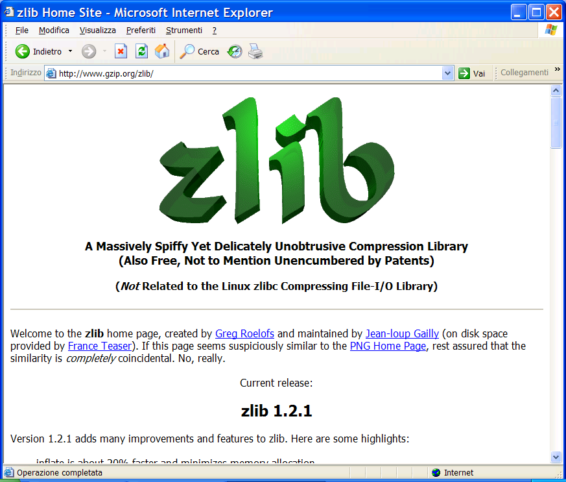
You find this at: www.gzip.org/zlib/

Slide 44
LZ78
Possibly better for cache effects
Dictionary:
substrings stored in a trie (each has an id).
Coding loop:
find the longest match S in the dictionary
Output its id and the next character c after the match in the input string
Add the substring Sc to the dictionary
Decoding:
builds the same dictionary and looks at ids

Slide 45
LZ78: Coding Example
Output
Dict.
a
a
b
a
a
c
a
b
c
a
b
c
b
(0,a)
1 = a
a
a
b
a
a
c
a
b
c
a
b
c
b
(1,b)
2 = ab
a
a
b
a
a
c
a
b
c
a
b
c
b
(1,a)
3 = aa
a
a
b
a
a
c
a
b
c
a
b
c
b
(0,c)
4 = c
a
a
b
a
a
c
a
b
c
a
b
c
b
(2,c)
5 = abc
a
a
b
a
a
c
a
b
c
a
b
c
b
(5,b)
6 = abcb

Slide 46
LZ78: Decoding Example
Input
Dict.
(0,a)
a
1 = a
(1,b)
a
a
b
2 = ab
(1,a)
a
a
b
a
a
3 = aa
(0,c)
a
a
b
a
a
c
4 = c
(2,c)
a
a
b
a
a
c
a
b
c
5 = abc
(5,b)
a
a
b
a
a
c
a
b
c
a
b
c
b
6 = abcb

Slide 47
LZW (Lempel-Ziv-Welch)
Don’t send extra character c, but still add Sc to the dictionary.
Dictionary:
initialized with 256 ascii entries (e.g. a = 112)
Decoder is one step behind the coder since it does not know c
There is an issue for strings of the form
SSc where S[0] = c, and these are handled specially!!!

Slide 48
LZW: Encoding Example
Output
Dict.
a
a
b
a
a
c
a
b
a
b
a
c
b
112
256=aa
a
a
b
a
a
c
a
b
a
b
a
c
b
112
257=ab
a
a
b
a
a
c
a
b
a
b
a
c
b
113
258=ba
a
a
b
a
a
c
a
b
a
b
a
c
b
256
259=aac
a
a
b
a
a
c
a
b
a
b
a
c
b
114
260=ca
a
a
b
a
a
c
a
b
a
b
a
c
b
257
261=aba
a
a
b
a
a
c
a
b
a
b
a
c
b
261
262=abac
a
a
b
a
a
c
a
b
a
b
a
c
b
114
263=cb

Slide 49
LZW: Decoding Example
Input
Dict
112
a
one
step
later
112
a
a
256=aa
113
a
a
b
257=ab
256
a
a
b
a
a
258=ba
114
a
a
b
a
a
c
259=aac
257
a
a
b
a
a
c
a
b
?
260=ca
261
261
a
a
b
a
a
c
a
b
a
b
261=aba
114

Slide 50
LZ78 and LZW issues
How do we keep the dictionary small?
Throw the dictionary away when it reaches a certain size (used in GIF)
Throw the dictionary away when it is no longer effective at compressing (e.g. compress)
Throw the least-recently-used (LRU) entry away when it reaches a certain size (used in BTLZ, the British Telecom standard)

Slide 51
Simple compressors: too simple?
Move-to-Front (MTF):
  As a freq-sorting approximator
  As a caching strategy
  As a compressor
Run-Length-Encoding (RLE):
  FAX compression
Notes:
Normal huffman codes are static.
To be applied in a dynamic model, we need a

Slide 52
Move to Front Coding
Transforms a char sequence into an integer sequence, that can then be var-length coded
Start with the list of symbols L=[a,b,c,d,…]
For each input symbol s
  output the position of s in L
  move s to the front of L
Properties:
Exploit temporal locality, and it is dynamic
X = 1^{n} 2^{n} 3^{n…} n^{n} → Huff = O(n² log n), MTF = O(n log n) + n²
In fact Huff takes log n bits per symbol being them equiprob
MTF uses O(1) bits per symbol occurrence but first one by γ-code.
There is a memory

Slide 53
Run Length Encoding (RLE)
If spatial locality is very high, then
abbbaacccca => (a,1),(b,3),(a,2),(c,4),(a,1)
In case of binary strings → just numbers and one bit
Properties:
Exploit spatial locality, and it is a dynamic code
X = 1^{n} 2^{n} 3^{n…} n^{n} →
Huff(X) = O(n² log n) > Rle(X) = O( n (1+log n) )
RLE uses log n bits per symb-block using γ-code per its length.
There is a memory
Notes:
Should each character have its own frequency distribution, or the same for all of them?

Slide 54
Data Compression
Burrows-Wheeler Transform

Slide 55
The big (unconscious) step...

Slide 56
The Burrows-Wheeler Transform (1994)
Let us given a text T = mississippi#
F
L
mississippi#
# mississipp i
ississippi#m
i #mississip p
ssissippi#mi
i ppi#missis s
sissippi#mis
i ssippi#mis s
issippi#miss
Sort the rows
i ssissippi# m
ssippi#missi
m ississippi #
T
sippi#missis
ippi#mississ
ppi#mississi
pi#mississip
i#mississipp
#mississippi
p i#mississi p
p pi#mississ i
s ippi#missi s
s issippi#mi s
s sippi#miss i
s sissippi#m i

Slide 57
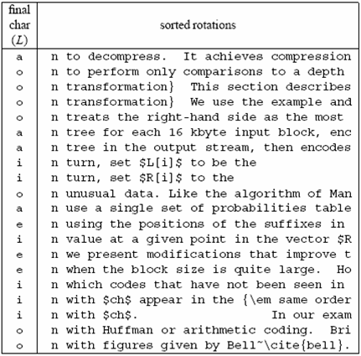
A famous example
Much
longer...

Slide 58
Compressing L seems promising...
Key observation:
L is locally homogeneous
L is highly compressible
Algorithm Bzip :
Move-to-Front coding of L
Run-Length coding
Statistical coder
Bzip vs. Gzip: 20% vs. 33%, but it is slower in (de)compression !

Slide 59
How to compute the BWT ?
SA
BWT matrix
L
We said that: L[i] precedes F[i] in T
12
11
8
5
2
1
10
9
7
4
6
3
#mississipp
i#mississip
ippi#missis
issippi#mis
ississippi#
mississippi
pi#mississi
ppi#mississ
sippi#missi
sissippi#mi
ssippi#miss
ssissippi#m
#mississipp
i#mississip
ippi#missis
issippi#mis
ississippi#
mississippi
pi#mississi
ppi#mississ
sippi#missi
sissippi#mi
ssippi#miss
ssissippi#m
i
p
s
s
m
#
p
i
s
s
i
i
L[3] = T[ 7 ]
Given SA and T, we have L[i] = T[SA[i]-1]

Slide 60
How to construct SA from T ?
SA
12
11
8
5
2
1
10
9
7
4
6
3
#
i#
ippi#
issippi#
ississippi#
mississippi
pi#
ppi#
sippi#
sissippi#
ssippi#
ssissippi#
Elegant but inefficient
Obvious inefficiencies:
Θ(n² log n) time in the worst-case
Θ(n log n) cache misses or I/O faults
Input: T = mississippi#

Slide 61
A useful tool: L → F mapping
F
unknown
L
# mississipp i
i #mississip p
i ppi#missis s
i ssippi#mis s
i ssissippi# m
m ississippi #
How do we map L’s onto F’s chars ?
p i#mississi p
p pi#mississ i
s ippi#missi s
s issippi#mi s
s sippi#miss i
s sissippi#m i
... Need to distinguish equal chars in F...
Take two equal L’s chars
Rotate rightward their rows
Same relative order !!

Slide 62
The BWT is invertible
F
unknown
L
# mississipp i
Two key properties:
i #mississip p
1. LF-array maps L’s to F’s chars
i ppi#missis s
2. L[ i ] precedes F[ i ] in T
i ssippi#mis s
i ssissippi# m
Reconstruct T backward:
m ississippi #
p
p
i
T = .... #
i
p i#mississi p
p pi#mississ i
s ippi#missi s
s issippi#mi s
s sippi#miss i
s sissippi#m i
InvertBWT(L)
Compute LF[0,n-1];
r = 0; i = n;
while (i>0) {
T[i] = L[r];
r = LF[r]; i--;
}

Slide 63
An encoding example
T = mississippimississippimississippi
# at 16
L = ipppssssssmmmii#pppiiissssssiiiiii
Mtf = [i,m,p,s]
Mtf = 020030000030030 300100300000100000
Mtf = 030040000040040 400200400000200000
Bin(6)=110, Wheeler’s code
Alphabet
|Σ|+1
RLE0 = 03141041403141410210
Bzip2-output = Arithmetic/Huffman on |Σ|+1 symbols...
... plus γ(16), plus the original Mtf-list (i,m,p,s)

Slide 64
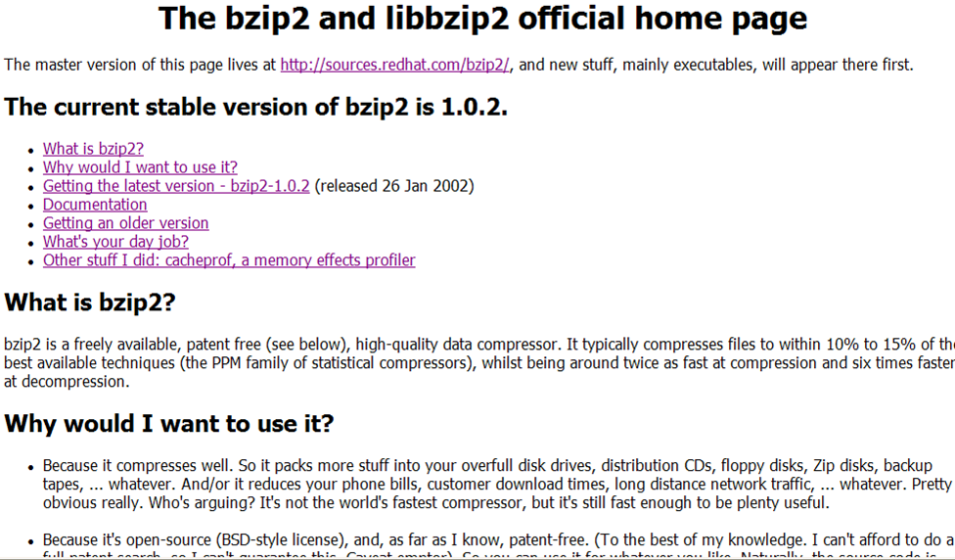
You find this in your Linux distribution

