Slide 1
Text Analytics
Università di Pisa
Giuseppe Attardi
Dipartimento di Informatica
Università di Pisa

Slide 2
Instructors
Giuseppe Attardi
Office: 292
mail: attardi@di.unipi.it
web: www.di.unipi.it/~attardi
Andrea Esuli
Office: CNR
mail: andrea.esuli@isti.cnr.it
web: www.esuli.it/

Slide 3
Course Info
Course Page:
http://didawiki.di.unipi.it/doku.php/mds/txa/start
Hours:
Monday 11-13, Room N1
Tuesday 9-11, Room N1

Slide 4
Exam
Project

Slide 5
Text Analytics
Need to analyze large amounts of text to discover useful information
Examples:
monitoring how the public discusses a product in social media
Anti-terrorism intelligence
This course provides students with an understanding of common and emerging methods of organizing, summarizing, and analyzing large collections of unstructured and lightly-structured text ('text analytics')
Focus on algorithms and techniques
Introduction to open-source software tools

Slide 6
Text Mining
The process of deriving high-quality information from text
High-quality information is typically derived through the devising of patterns and trends through means such as statistical pattern learning
aims to turn text into data for analysis, via application of natural language processing (NLP) and analytical methods.

Slide 7
Structured vs Unstructured Data
85 percent of business-relevant information originates in unstructured form, primarily text, according to Anant Jhingran of IBM Research.
Information is mostly communicated by reading or writing e-mails, reports, or articles and the like, in conversations, or by listening/watching media
Attempts to turn text into structured (HTML) or microformat only scratch the surface
Problems:
Requires universal agreed ontologies
Additional effort
Entity linking attempts to provide a bridge

Slide 8
NLP
Computers would be a lot more useful if they could handle our email, do our library research, chat to us …
But they are fazed by natural languages
Or at least their programmers are … most people just avoid the problem and get into XML, or menus and drop boxes, or …
Big challenge
How can we teach language to computers?
Or help them learn it as kids do?

Slide 9
NL: Science Fiction
Star Trek
universal translator: Babel Fish
Language Interaction

Slide 10
September 2016
DeepMind (an Alphabet company, aka Google) announces
WaweNet: A Generative Model for Raw Audio

Slide 11
Quiz Bowl Competition
Iyyer et al. 2014: A Neural Network for Factoid Question Answering over Paragraphs
QUESTION:
He left unfinished a novel whose title character forges his father’s signature to get out of school and avoids the draft by feigning desire to join.
One of his novels features the Jesuit Naptha and his opponent Settembrini, while his most famous work depicts the aging writer Gustav von Aschenbach.
Name this German author of The Magic Mountain and Death in Venice.
ANSWER: Thomas Mann

Slide 12
QANTA vs Ken Jennings
QUESTION:
Along with Evangelista Torricelli, this man is the namesake of a point the minimizes the distances to the vertices of a triangle.
He developed a factorization method …
ANSWER: Fermat
QUESTION:
A movie by this director contains several scenes set in the Yoshiwara Nightclub.
In a movie by this director a man is recognized by a blind beggar because he is wistlin In the hall of the mountain king.
ANSWER: Fritz Lang

Slide 13
Early history of NLP: 1950s
Early NLP (Machine Translation) on machines less powerful than pocket calculators
Foundational work on automata, formal languages, probabilities, and information theory
First speech systems (Davis et al., Bell Labs)
MT heavily funded by military – a lot of it was just word substitution programs but there were a few seeds of later successes, e.g., trigrams
Little understanding of natural language syntax, semantics, pragmatics
Problem soon appeared intractable

Slide 14
Recent Breakthroughs
Watson at Jeopardy! Quiz:
http://www.aaai.org/Magazine/Watson/watson.php
Final Game
PBS report
Google Translate on iPhone
http://googleblog.blogspot.com/2011/02/introducing-google-translate-app-for.html
Apple SIRI

Slide 15
Smartest Machine on Earth
IBM Watson beats human champions at TV quiz Jeopardy!
State of the art Question Answering system

Slide 16
Tsunami of Deep Learning
AlphaGo beats human champion at Go.
RankBrain is third most important important factor in the ranking algorithm along with links and content at Google
RankBrain is given batches of historical searches and learns to make predictions from these
It learns to deal also with queries and words never seen before
Most likely it is using Word Embeddings

Slide 17
Dependency Parsing
DeSR is online since 2007
Stanford Parser
Google Parsey McParseFace in 2016

Slide 18
Google
“At Google, we spend a lot of time thinking about how computer systems can read and understand human language in order to process it in intelligent ways.”
Parser used to analyze most of text processed
Parser used in Machine Translation

Slide 19
Apple SIRI
ASR (Automated Speech Recognition) integrated in mobile phone
Special signal processing chip for noise reduction
SIRI ASR
Cloud service for analysis
Integration with applications

Slide 20
Google Voice Actions
Google: what is the population of Rome?
Google: how tall is Berlusconi
How old is Lady Gaga
Who is the CEO of Tiscali
Who won the Champions League
Send text to Gervasi Please lend me your tablet
Navigate to Palazzo Pitti in Florence
Call Antonio Cisternino
Map of Pisa
Note to self publish course slides
Listen to Dylan

Slide 21
Technological Breakthrough
Machine learning
Huge amount of data
Large processing capabilities

Slide 22
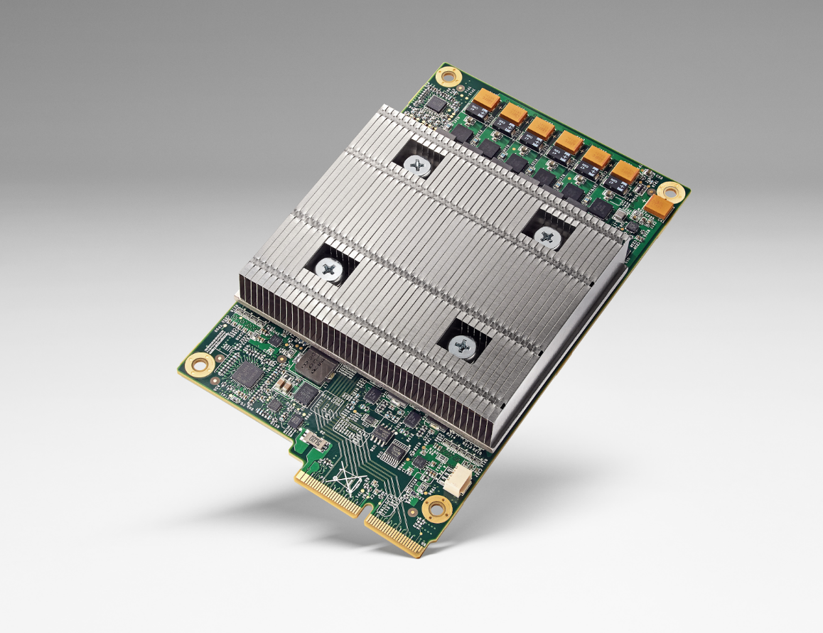
Big Data & Deep Learning
Requires high speed computing
Typical using GPUs
Eg. NVIDIA TESLA
Google custom chip TPU
10x more power per watt
Half precision floats

Slide 23
AlphaGo
Exploiting Deep Learning and Reinforcement Learning, running on TPU equipped machines, the program AlphaGo by DeepMind has beaten the world champion at the game of Go, on March 9, 2016.
The story has been told in a movie.

Slide 24
Big Data Science & Artificial Intelligence
Both use Big Data
Different kind and different use
Statistical Analysis of Big Data use raw data and extract correlations or statistical indicators
AI needs annotated data by humans, from which to learn behaviors to perform similar tasks in other situations
Man in the loop in data used for ML in AI:
data produced by humans and annotated by humans, enter the learning cycle of human behaviors

Slide 25
Unreasonable Effectiveness of Data
Halevy, Norvig, and Pereira argue that we should stop acting as if our goal is to author extremely elegant theories, and instead embrace complexity and make use of the best ally we have: the unreasonable effectiveness of data.
A simpler technique on more data beat a more sophisticated technique on less data.
Language in the wild, just like human behavior in general, is messy.

Slide 26
Scientific Dispute: is it science?
Prof. Noam Chomsky, Linguist, MIT
Peter Norvig, Director of research, Google

Slide 27
Chomsky
It's true there's been a lot of work on trying to apply statistical models to various linguistic problems. I think there have been some successes, but a lot of failures. There is a notion of success ... which I think is novel in the history of science. It interprets success as approximating unanalyzed data.
http://norvig.com/chomsky.html

Slide 28
Norvig
I agree that engineering success is not the goal or the measure of science. But I observe that science and engineering develop together, and that engineering success shows that something is working right, and so is evidence (but not proof) of a scientifically successful model.
Science is a combination of gathering facts and making theories; neither can progress on its own. I think Chomsky is wrong to push the needle so far towards theory over facts; in the history of science, the laborious accumulation of facts is the dominant mode, not a novelty. The science of understanding language is no different than other sciences in this respect.
I agree that it can be difficult to make sense of a model containing billions of parameters. Certainly a human can't understand such a model by inspecting the values of each parameter individually. But one can gain insight by examining the properties of the model—where it succeeds and fails, how well it learns as a function of data, etc.

Slide 29
Norvig (2)
Einstein said to make everything as simple as possible, but no simpler. Many phenomena in science are stochastic, and the simplest model of them is a probabilistic model; I believe language is such a phenomenon and therefore that probabilistic models are our best tool for representing facts about language, for algorithmically processing language, and for understanding how humans process language.
I agree with Chomsky that it is undeniable that humans have some innate capability to learn natural language, but we don't know enough about that capability to rule out probabilistic language representations, nor statistical learning. I think it is much more likely that human language learning involves something like probabilistic and statistical inference, but we just don't know yet.

Slide 30
Linguistic Analysis
Two reasons:
Exploiting digital knowledge
Communicating with computer assistants

Slide 31
Why to study human language?

Slide 32
AI is fascinating since it is the only discipline where the mind is used to study itself
Luigi Stringa, director FBK

Slide 33
Language and Intelligence
“Understanding cannot be measured by external behavior; it is an internal metric of how the brain remembers things and uses its memories to make predictions”.
“The difference between the intelligence of humans and other mammals is that we have language”.
Jeff Hawkins, “On Intelligence”, 2004

Slide 34
Hawkins’ Memory-Prediction framework
The brain uses vast amounts of memory to create a model of the world. Everything you know and have learned is stored in this model. The brain uses this memory-based model to make continuous predictions of future events. It is the ability to make predictions about the future that is the crux of intelligence.

Slide 35
More …
“Spoken and written words are just patterns in the world…
The syntax and semantics of language are not different from the hierarchical structure of everyday objects.
We associate spoken words with our memory of their physical and semantic counterparts.
Through language one human can invoke memories and create next justapositions of mental objects in another human.”

Slide 36
Thirty Million Words
The number of words a child hears in early life will determine their academic success and IQ in later life.
Researchers Betty Hart and Todd Risley (1995) found that children from professional families heard thirty million more words in their first 3 years
http://www.youtube.com/watch?v=qLoEUEDqagQ

Slide 37
Exploiting Knowledge

Slide 38
Knowledge is Power
But only if you know how to acquire it …
The Economist, May 8, 2003
Knowledge Extraction
Requires
Repositories of knowledge
Mechanism for using knowledge

Slide 39
Linguistic Applications
So far self referential: from language to language
Classification
Extraction
Summarization
More challenging:
Derive conclusion
Perform actions

Slide 40
Natural Language Understanding is difficult
The hidden structure of language is highly ambiguous
Structures for: Fed raises interest rates 0.5% in effort to control inflation (NYT headline 5/17/00)
Slide by C. Manning

Slide 41
Where are the ambiguities?
Slide by C. Manning

Slide 42
Newspaper Headlines
Minister Accused Of Having 8 Wives In Jail
Juvenile Court to Try Shooting Defendant
Teacher Strikes Idle Kids
China to Orbit Human on Oct. 15
Local High School Dropouts Cut in Half
Red Tape Holds Up New Bridges
Clinton Wins on Budget, but More Lies Ahead
Hospitals Are Sued by 7 Foot Doctors
Police: Crack Found in Man's Buttocks

Slide 43
Reference Resolution
U: Where is The Green Hornet playing in Mountain View?
S: The Green Hornet is playing at the Century 16 theater.
U: When is it playing there?
S: It’s playing at 2pm, 5pm, and 8pm.
U: I’d like 1 adult and 2 children for the first show. How much would that cost?
Knowledge sources:
Domain knowledge
Discourse knowledge
World knowledge

Slide 44
NLP hard
Natural language is:
highly ambiguous at all levels
complex and subtle use of context to convey meaning
fuzzy?, probabilistic
involves reasoning about the world
a key part of people interacting with other people (a social system):
persuading, insulting and amusing them
But NLP can also be surprisingly easy sometimes:
rough text features can often do half the job

Slide 45
Hidden Structure of Language
Going beneath the surface…
Not just string processing
Not just keyword matching in a search engine
Search Google on “tennis racquet” and “tennis racquets” or “laptop” and “notebook” and the results are quite different … though these days Google does lots of subtle stuff beyond keyword matching itself
Not just converting a sound stream to a string of words
Like Nuance/IBM/Dragon/Philips speech recognition
To recover and manipulate at least some aspects of language structure and meaning

Slide 46
About the Course
Assumes some skills…
basic linear algebra, probability, and statistics
decent programming skills
willingness to learn missing knowledge
Teaches key theory and methods for Statistical NLP
Useful for building practical, robust systems capable of interpreting human language
Experimental approach:
Lots of problem-based learning
Often practical issues are as important as theoretical niceties

Slide 47
Experimental Approach
Formulate Hypothesis
Implement Technique
Train and Test
Apply Evaluation Metric
If not improved:
Perform error analysis
Revise Hypothesis
Repeat

Slide 48
Program
Introduction
History
Present and Future
NLP and the Web
Mathematical Background
Probability and Statistics
Language Model
Hidden Markov Model
Viterbi Algorithm
Linguistic Essentials
Part of Speech and Morphology
Phrase structure
Collocations
n-gram Models
Word Sense Disambiguation
Word Embeddings

Slide 49
Preprocessing
Encoding
Regular Expressions
Segmentation
Tokenization
Normalization
NLTK
Introduction to Python
Overview of NLTK libraries

Slide 50
Classification
Machine Learning
Statistical classifiers
Bayesan Network
Perceptron
Maximum Entropy
Support Vector Machines
Hidden Variable Models
Clustering
K-means
Factored Models

Slide 51
Tagging
Part of Speech
Named Entity
Sentence Structure
Constituency Parsing
Dependency Parsing
Semantic Analysis
Semantic Role Labeling
Coreference resolution
Statistical Machine Translation
Phrase-Based Models
Neural Network Models
Evaluation metrics

Slide 52
Deep Learning
Libraries
NLTK
Theano/Keras
Tensorflow
Applications
Opinion Mining
Entity Linking
Semantic Search
Question Answering
Language Inference

Slide 53
Opinion Mining
Introduction to sentiment analysis
Sentiment classification
Lexical resources for sentiment analysis
Neural Language Models (Word2Vec, Doc2Vec)
Ordinal regression
Opinion extraction
Data collection
Quantification
Spam: mail spam, scams, phishing, web & social network spam, review spam
Cross-media retrieval

Slide 54
Exam
Project
Seminar

Slide 55
Previous Year Projects
Participation to Evalita 2011
Task POS + Lemmatization: 1st position
Task Domain Adaptation: 1st position
Task SuperSense: 1st position
Task Dependency Parsing: 2nd position
Task NER: 3rd position
SemEval 2012
Sentiment Analysis on tweets
Participation to Evalita 2014
Sentiment Analysis on tweets
Disaster Reports in Tweets

Slide 56
Last Year Projects
Participation to Evalita 2016
Task POS on Tweets:
Task Sentipolc on Twitter: 1st position
Task Named Entity Linking:

Slide 57
Books
C. Manning, H. Schutze. Foundations of Statistical Natural Language Processing. MIT Press, 2000.
D. Jurafsky, J.H. Martin, Speech and Language Processing. 2nd edition, Prentice-Hall, 2008.
S. Kubler, R. McDonald, J. Nivre. Dependency Parsing. 2010.
P. Koehn. Statistical Machine Translation. Cambridge University Press, 2010.
S. Bird, E. Klein, E. Loper. Natural Language Processing with Python.
I. Goodfellow, Yoshua Bengio and A. Courville, Deep Learning, http://www.deeplearningbook.org, 2016.

