Slide 1
Classification
Giuseppe Attardi
Università di Pisa

Slide 2
Classification
Define classes/categories
Label text
Extract features
Choose a classifier
  Naive Bayes Classifier
  Decision Trees
  Maximum Entropy
  …
Train it
Use it to classify new examples

Slide 3
Naïve Bayes
More powerful than Decision Trees
Decision Trees
Naïve Bayes
Every feature gets a say in determining
which label should be assigned to a given input value.
Slide from Heng Ji

Slide 4
Naïve Bayes: Strengths
Very simple model
  Easy to understand
  Very easy to implement
Can scale easily to millions of training examples (just need counts!)
Very efficient, fast training and classification
Modest space storage
Widely used because it works really well for text categorization
Linear, but non parallel decision boundaries
Slide from Heng Ji

Slide 5
Naïve Bayes: weaknesses
Naïve Bayes independence assumption has two consequences:
  The linear ordering of words is ignored (bag of words model)
  The words are independent of each other given the class:
    President is more likely to occur in a context that contains election than in a context that contains poet
Naïve Bayes assumption is inappropriate if there are strong conditional dependencies between the variables
Nonetheless, Naïve Bayes models do well in a surprisingly large number of cases because often we are interested in classification accuracy and not in accurate probability estimations)
Does not optimize prediction accuracy
Slide from Heng Ji

Slide 6
The naivete of independence
Naïve Bayes assumption is inappropriate if there are strong conditional dependencies between the variables
Classifier may end up "double-counting" the effect of highly correlated features, pushing the classifier closer to a given label than is justified
Consider a name gender classifier
  features ends-with(a) and ends-with(vowel) are dependent on one another, because if an input value has the first feature, then it must also have the second feature
  For features like these, the duplicated information may be given more weight than is justified by the training set
Slide from Heng Ji

Slide 7
Decision Trees: Strengths
capable to generate understandable rules
perform classification without requiring much computation
capable to handle both continuous and categorical variables
provide a clear indication of which features are most important for prediction or classification.
Slide from Heng Ji

Slide 8
Decision Trees: weaknesses
prone to errors in classification problems with many classes and relatively small number of training examples.
  Since each branch in the decision tree splits the training data, the amount of training data available to train nodes lower in the tree can become quite small.
can be computationally expensive to train.
  Need to compare all possible splits
  Pruning is also expensive
Slide from Heng Ji

Slide 9
Decision Trees: weaknesses
Typically examine one field at a time
Leads to rectangular classification boxes that may not correspond well with the actual distribution of records in the decision space.
  Such ordering limits their ability to exploit features that are relatively independent of one another
  Naive Bayes overcomes this limitation by allowing all features to act "in parallel"
Slide from Heng Ji

Slide 10
Linearly separable data
Linear Decision boundary
Class1
Class2
Slide from Heng Ji

Slide 11
Non linearly separable data
Class1
Class2
Slide from Heng Ji

Slide 12
Non linearly separable data
Non Linear Classifier
Class1
Class2
Slide from Heng Ji

Slide 13
Linear versus Non Linear algorithms
Linear or Non linear separable data?
  We can find out only empirically
Linear algorithms (algorithms that find a linear decision boundary)
  When we think the data is linearly separable
  Advantages
    Simpler, less parameters
  Disadvantages
    High dimensional data (like for NLP) is usually not linearly separable
  Examples: Perceptron, Winnow, large margin
  Note: we can use linear algorithms also for non linear problems (see Kernel methods)
Slide from Heng Ji

Slide 14
Linear versus Non Linear algorithms
Non Linear algorithms
  When the data is non linearly separable
  Advantages
    More accurate
  Disadvantages
    More complicated, more parameters
  Example: Kernel methods
  Note: the distinction between linear and non linear applies also for multi-class classification (we’ll see this later)
Slide from Heng Ji

Slide 15
Simple linear algorithms
Perceptron algorithm
  Linear
  Binary classification
  Online (process data sequentially, one data point at the time)
  Mistake driven
  Simple single layer Neural Networks
Slide from Heng Ji

Slide 16
Linear Algebra

Slide 17
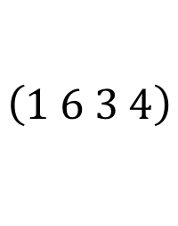
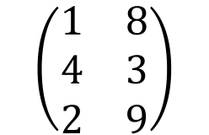
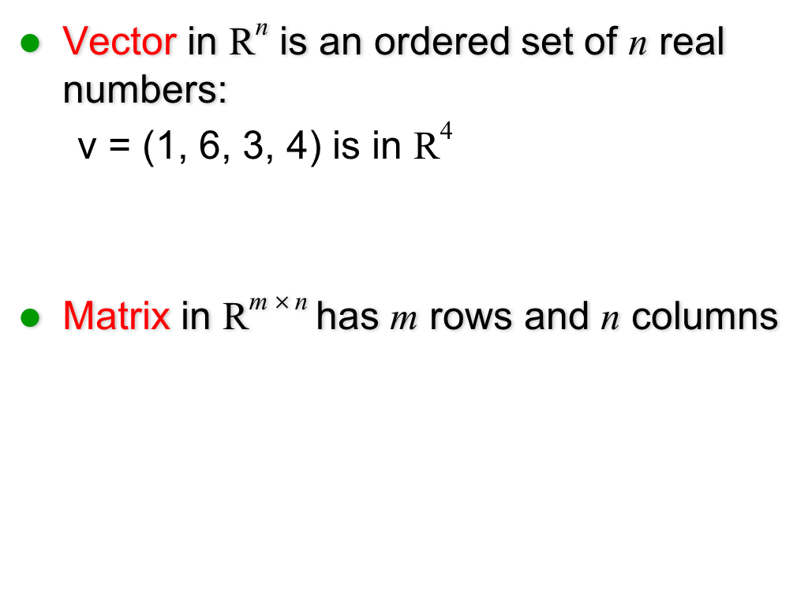
Basic concepts
Vector in R^{n} is an ordered set of n real numbers:
  v = (1, 6, 3, 4) is in R⁴
Matrix in R^{m} $×$^{n} has m rows and n columns
$$\left(1 6 3 4\right)$$
$$\left(\begin{matrix}1 & 8 \\ 4 & 3 \\ 2 & 9\end{matrix}\right)$$

Slide 18
Vector Addition
v+w
v
w

Slide 19
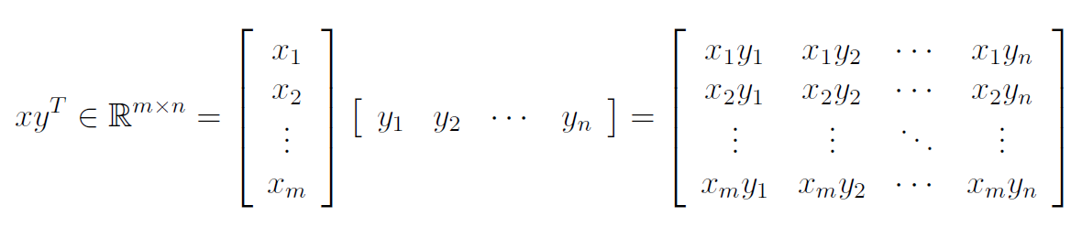
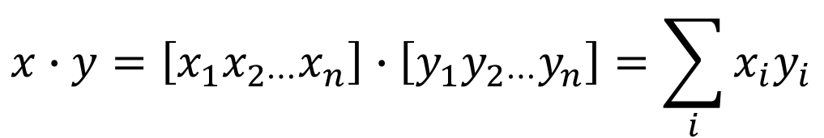
Vector Products
Vector dot (inner) product:
Vector outer product:
$$x∙y=\left[x_{1}x_{2⋯}x_{n}\right]∙\left[y_{1}y_{2⋯}y_{n}\right]=\sum_{i}{x_{i}y_{i}}$$

Slide 20
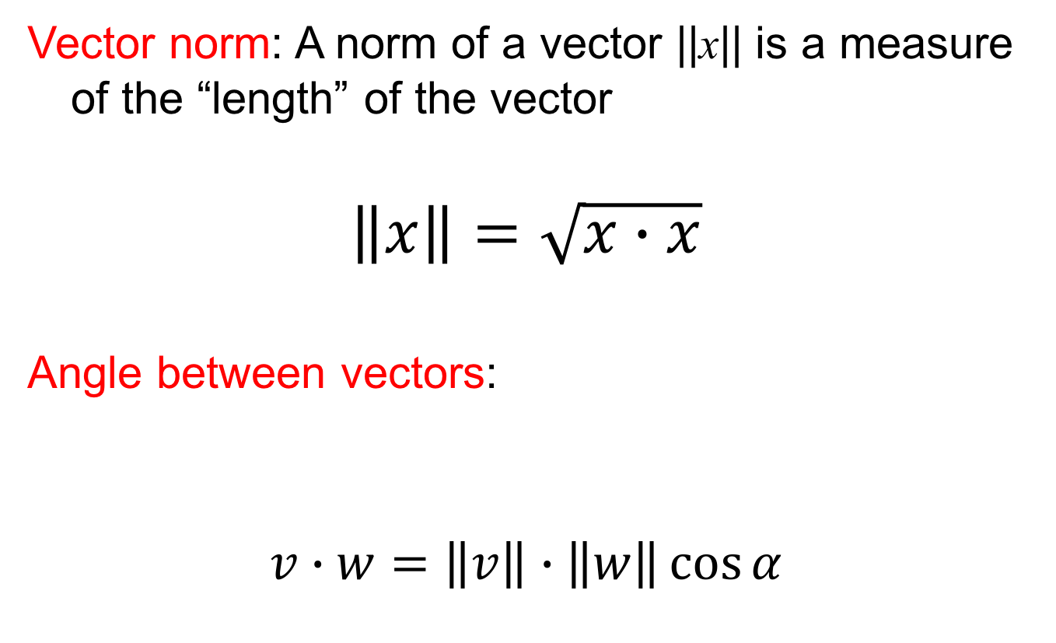
Geometrical Interpretation
Vector norm: A norm of a vector ||x|| is a measure of the “length” of the vector
$$\left\|x\right\|=\sqrt{x∙x}$$
Angle between vectors:
$$v∙w=\left\|v\right\|∙\left\|w\right\|\cos{α}$$
v
α
w

Slide 21



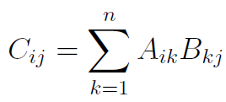
Matrix Product
Matrix product:
Example:

Slide 22
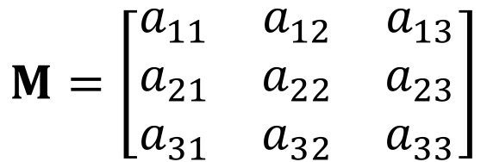
Vector-Matrix Product
$$M=\left[\begin{matrix}a_{11} & a_{12} & a_{13} \\ a_{21} & a_{22} & a_{23} \\ a_{31} & a_{32} & a_{33}\end{matrix}\right]$$

Slide 23
Hyperplane
Hyperplane equation: wx + b = 0
wx + b > 0
wx + b = 0
-b/w₂
w
wx + b < 0

Slide 24
Vector of features
word is capitalized (Trump)
word made of digits (2016)
all upper (USA)
tree = <0, 0, 0>
Dylan = <1, 0, 0>
Binary features

Slide 25
Non binary features
Bag of words
“the presence of words in the document”
[2, 1, 1, 1, 1, 1]
“the absence of words in the document”
[2, 0, 1, 1, 1, 1, 1]
Use a dictionary to assign an index to each word:
dict[newword] = len(dict)

Slide 26
Linear binary classification
Data: {(x_{i}, y_{i})}_{i=1…n}
  x in R^{d} (x is a vector in d-dimensional space)
  → feature vector
  y in {−1,+1}
  → label (class, category)
Question:
  Find a linear decision boundary: wx + b (hyperplane)
  such that the classification rule associated with it has minimal probability of error
  classification rule:
    y = sign(w x + b) which means:
    if wx + b > 0 then y = +1
    if wx + b < 0 then y = −1
    Gert Lanckriet, Statistical Learning Theory Tutorial

Slide 27
Linear binary classification
Find a good hyperplane
(w, b) in R^{d+1}
that correctly classifies data points as much as possible
In online fashion: one data point at the time, update weights as necessary
wx + b = 0
Classification Rule:
y = sign(wx + b)
    G. Lanckriet, Statistical Learning Theory Tutorial

Slide 28
Perceptron

Slide 29
The Perceptron
Frank Rosenblatt (1962). Principles of Neurodynamics, Spartan, New York, NY.
Subsequent progress was inspired by the invention of learning rules inspired by ideas from neuroscience…
Rosenblatt’s Perceptron could automatically learn to categorise or classify input vectors into types.
It obeyed the following rule:
If the sum of the weighted inputs exceeds a threshold, output 1, else output 0.
Σx_{i} w_{i}
1 if Σ input_{i *} weight_{i} > threshold
0 if Σ input_{i *} weight_{i} < threshold
weights
sum
output
inputs
*

Slide 30
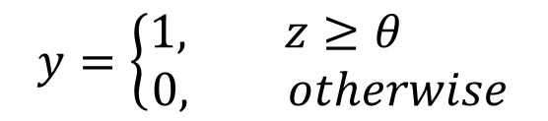
Binary threshold neurons
McCulloch-Pitts (1943)
  First compute a weighted sum of the inputs from other neurons
  Then output a 1 if the weighted sum exceeds the threshold.
y
1
0
z
threshold

Slide 31
Perceptron as Single Layer Neural Network
Σ
y = sign(wx + b)

Slide 32
Multi-layer Perceptron
x₁
x₂
Input
Output
x_{n}
Hidden layers

Slide 33
Properties of Architecture
No connections within a layer
No direct connections between input and output layers
Fully connected between layers
Often more than 3 layers
Number of output units need not equal number of input units
Number of hidden units per layer can be more or less than
input or output units
Each unit is a perceptron
Often include bias as an extra weight

Slide 34
What do each of the layers do?
1st layer draws linear boundaries
2nd layer combines the boundaries
3rd layer can generate arbitrarily complex boundaries

Slide 35
Perceptron Learning Rule
Assuming the problem is linearly separable, there is a learning rule that converges in a finite time
Motivation
A new (unseen) input pattern that is similar to an old (seen) input pattern is likely to be classified correctly

Slide 36
Learning Rule
Basic Idea
  go over all existing data patterns, whose labeling is known, and check their classification with a current weight vector
  If correct, continue
  If not, add to the weights a quantity proportional to the product of the input pattern with the desired output Y (+1 or -1)

Slide 37
Hebb Rule
In 1949, Hebb postulated that the changes in a synapse are proportional to the correlation between firing of the neurons that are connected through the synapse (the pre- and post- synaptic neurons)
Neurons that fire together, wire together

Slide 38
Example: a simple problem
4 points linearly separable
2
1.5
(1/2, 1)
1
x₀ (-1,1/2)
0.5
(1,1/2)
0
y = +1
y = -1
-0.5
x₁ (-1,1)
-1
-1.5
-2
-2
-1.5
-1
-0.5
0
0.5
1
1.5
2

Slide 39
Initial Weights
2
1.5
w₀ = (0, 1)
(1/2, 1)
1
(-1,1/2)
0.5
(1,1/2)
0
-0.5
(-1,1)
-1
-1.5
-2
-2
-1.5
-1
-0.5
0
0.5
1
1.5
2

Slide 40
Updating Weights
Learning rule is:
  w_{i+1} = w_{i} + Δw_{i}
where:
  ε is learning rate
ε = 1/3 , w₀ = (0, 1), x₀ = (-1, ½)
Δw₀ = 1/3 (-1, ½) (0 – sign(w₀ x₀))
= 1/3 (-1,1/2) (-1)
= (1/3, -1/6)
w₁ = (0, 1) + (1/3, -1/6) = (1/3, 5/6)

Slide 41
First Correction
2
1.5
w₁ = (1/3,5/6)
1
0.5
0
-0.5
-1
-1.5
-2

Slide 42
Updating Weights
Upper left point is still wrongly classified
w₂ = w₁ + Δw₁
Δw₁ = 1/3 (-1, ½) (0 – sign(w₁ x₁))
w₂ = (1/3, 5/6) + 1/3 ⋅ -1 ⋅ (-1, 1/2) = (2/3, 2/3)

Slide 43
Second Correction
2
1.5
w₂ = (2/3,2/3)
1
0.5
0
-0.5
-1
-1.5
-2

Slide 44
Example
All 4 points are classified correctly
Toy problem – only 2 updates required
Correction of weights was simply a
rotation of the separating hyper plane
Rotation can be applied to the right direction, but may require many updates

Slide 45
Deriving the delta rule
Define the error as the squared residuals summed over all training cases
Now differentiate to get error derivatives for weights
The batch delta rule changes the weights in proportion to their error derivatives summed over all training cases

Slide 46
The error surface
The error surface lies in a space with a horizontal axis for each weight and one vertical axis for the error.
  For a linear neuron, it is a quadratic bowl.
  Vertical cross-sections are parabolas.
  Horizontal cross-sections are ellipses.
E
w₁
w₂

Slide 47
Gradient Descent
Online learning zig-zags around the direction of steepest descent
constraint from
training case 1
w₁
constraint from
training case 2
w₂

Slide 48
Support Vector Machines

Slide 49
Large margin classifier
Another family of linear algorithms
Intuition (Vapnik, 1965)
If the classes are linearly separable:
  Separate the data
  Place hyper-plane “far” from the data: large margin
  Statistical results guarantee good generalization
BAD
    Gert Lanckriet, Statistical Learning Theory Tutorial

Slide 50
Large margin classifier
Intuition (Vapnik, 1965) if linearly separable:
  Separate the data
  Place hyperplane “far” from the data: large margin
  Statistical results guarantee good generalization
GOOD
→ Maximal Margin Classifier
    Gert Lanckriet, Statistical Learning Theory Tutorial

Slide 51
Large margin classifier
If not linearly separable
  Allow some errors
  Still, try to place hyperplane “far” from each class
    Gert Lanckriet, Statistical Learning Theory Tutorial

Slide 52
Large Margin Classifiers
Advantages
  Theoretically better (better error bounds)
Limitations
  Computationally more expensive, large quadratic programming

Slide 53
Linear Classifiers
α
x
f
̑y
f(x,w,b) = sign(w x + b)
denotes +1
denotes -1
w x + b>0
w x + b=0
How would you classify this data?
w x + b<0

Slide 54
Linear Classifiers
α
x
f
̑y
denotes +1
denotes -1
f(x,w,b) = sign(w x + b)
How would you classify this data?

Slide 55
Linear Classifiers
α
x
f
̑y
f(x,w,b) = sign(w x + b)
denotes +1
denotes -1
How would you classify this data?

Slide 56
Linear Classifiers
α
x
f
̑y
f(x,w,b) = sign(w x + b)
denotes +1
denotes -1
Any of these would be fine..
..but which is best?

Slide 57
Linear Classifiers
α
x
f
̑y
denotes +1
denotes -1
f(x,w,b) = sign(w x + b)
How would you classify this data?
Misclassified
to +1 class

Slide 58
Classifier Margin
α
α
x
x
f
f
y^{est}
y^{est}
f(x,w,b) = sign(w x + b)
denotes +1
denotes -1
denotes +1
denotes -1
Define the margin of a linear classifier as the width that the boundary could be increased by before hitting a datapoint.
Define the margin of a linear classifier as the width that the boundary could be increased by before hitting a datapoint.

Slide 59
Maximum Margin
α
x
f
y^{est}
Maximizing the margin is good according to intuition and PAC theory
Implies that only support vectors are important; other training examples are ignorable.
Empirically it works very very well.
f(x,w,b) = sign(w x + b)
denotes +1
denotes -1
The maximum margin linear classifier is the linear classifier with the, um, maximum margin.
This is the simplest kind of SVM (Called an LSVM)
Support Vectors are those datapoints that the margin pushes up against
Linear SVM

Slide 60
Linear SVM Mathematically
x⁺
M=Margin Width
“Predict Class = +1” zone
X⁻
wx+b=1
“Predict Class = -1” zone
wx+b=0
wx+b=-1
What we know:
w . x⁺ + b = +1
w . x⁻ + b = -1
w . (x⁺-x⁻) = 2

Slide 61
Linear SVM Mathematically
Goal: 1) Correctly classify all training data
if y_{i} = +1
if y_{i} = -1
for all i
2) Maximize the Margin
same as minimize
We can formulate a Quadratic Optimization Problem and solve for w and b
Minimize
subject to

Slide 62
Solving the Optimization Problem
Find w and b such that
Φ(w) =½ w^{T}w is minimized;
and for all {(x_{i} ,y_{i})}: y_{i} (w^{T}x_{i} + b) ≥ 1
Need to optimize a quadratic function subject to linear constraints.
Quadratic optimization problems are a well-known class of mathematical programming problems, and many (rather intricate) algorithms exist for solving them.
The solution involves constructing a dual problem where a Lagrange multiplier α_{i} is associated with every constraint in the primary problem:
Find α₁…α_{N} such that
Q(α) = Σα_{i} - ½ΣΣα_{i}α_{j}y_{i}y_{j}x_{i}^{T}x_{j} is maximized and
(1) Σα_{i}y_{i} = 0
(2) α_{i} ≥ 0 for all α_{i}

Slide 63
The Optimization Problem Solution
The solution has the form:
Each non-zero α_{i} indicates that corresponding x_{i} is a support vector.
Then the classifying function will have the form:
Notice that it relies on an inner product between the test point x and the support vectors x_{i}
Also keep in mind that solving the optimization problem involved computing the inner products x_{i}^{T}x_{j} between all pairs of training points.
w =Σα_{i}y_{i}x_{i} b= y_{k}- w^{T}x_{k} for any x_{k} such that α_{k}≠ 0
f(x) = Σα_{i}y_{i}x_{i}^{T}x + b

Slide 64
Linear SVMs: Overview
The classifier is a separating hyperplane.
Most “important” training points are support vectors; they define the hyperplane.
Quadratic optimization algorithms can identify which training points x_{i} are support vectors with non-zero Lagrangian multipliers α_{i}.
Both in the dual formulation of the problem and in the solution training points appear only inside dot products:
Find α₁…α_{N} such that
Q(α) =Σα_{i} - ½ΣΣα_{i}α_{j}y_{i}y_{j}x_{i}^{T}x_{j} is maximized and
(1) Σα_{i}y_{i} = 0
(2) 0 ≤ α_{i} ≤ C for all α_{i}
f(x) = Σα_{i}y_{i}x_{i}^{T}x + b

Slide 65
Non Linear problem

Slide 66
Non Linear problem

Slide 67
Non Linear problem
Kernel methods
A family of non-linear algorithms
Transform the non linear problem in a linear one (in a different feature space)
Use linear algorithms to solve the linear problem in the new space
    Gert Lanckriet, Statistical Learning Theory Tutorial

Slide 68
Basic principle kernel methods
Φ : R^{d} → R^{D} (D >> d)
w^{T}Φ(x)+b=0
X=[x z]
Φ(X)=[x² z² xz]
f(x) = sign(w₁x²+w₂z²+w₃xz +b)
    Gert Lanckriet, Statistical Learning Theory Tutorial

Slide 69
Basic principle kernel methods
Linear separability: more likely in high dimensions
Mapping: Φ maps input into high-dimensional feature space
Classifier: construct linear classifier in high-dimensional feature space
Motivation: appropriate choice of Φ leads to linear separability
We can do this efficiently!
    Gert Lanckriet, Statistical Learning Theory Tutorial

Slide 70
Basic principle kernel methods
We can use the linear algorithms seen before (for example, perceptron) for classification in the higher dimensional space

Slide 71
Non-linear SVMs
Datasets that are linearly separable with some noise work out great:
But what are we going to do if the dataset is just too hard?
How about… mapping data to a higher-dimensional space:
0
x
0
x
x²
0
x

Slide 72
Non-linear SVMs: Feature spaces
General idea: the original input space can always be mapped to some higher-dimensional feature space where the training set is separable:
Φ: x → φ(x)

Slide 73
The “Kernel Trick”
The linear classifier relies on dot product between vectors K(x_{i},x_{j}) = x_{i}^{T}x_{j}
If every data point is mapped into high-dimensional space via some transformation Φ: x → φ(x), the dot product becomes:
K(x_{i},x_{j}) = φ(x_{i}) ^{T}φ(x_{j})
A kernel function is some function that corresponds to an inner product in some expanded feature space
Example:
x = [x₁ x₂]; let K(x_{i},x_{j}) = (1 + x_{i}^{T}x_{j})²,
Need to show that K(x_{i},x_{j}) = φ(x_{i}) ^{T}φ(x_{j}):
K(x_{i},x_{j}) = (1 + x_{i}^{T}x_{j})²
= 1+ x_{i1}²x_{j1}² + 2 x_{i1}x_{j1} x_{i2}x_{j2}+ x_{i2}²x_{j2}² + 2x_{i1}x_{j1} + 2x_{i2}x_{j2}
= [1 x_{i1}² √2 x_{i1}x_{i2} x_{i2}² √2x_{i1} √2x_{i2}]^{T} [1 x_{j1}² √2 x_{j1}x_{j2} x_{j2}² √2x_{j1} √2x_{j2}]
= φ(x_{i}) ^{T}φ(x_{j})
where φ(x) = [1 x₁² √2 x₁x₂ x₂² √2x₁ √2x₂]

Slide 74
What Functions are Kernels?
For some functions K(x_{i},x_{j}) checking that
K(x_{i},x_{j}) = φ(x_{i}) ^{T}φ(x_{j}) can be cumbersome
Mercer’s theorem:
Every semi-positive definite symmetric function is a kernel

Slide 75
Examples of Kernel Functions
Linear: K(x_{i}, x_{j})= x_{i} ^{T}x_{j}
Polynomial of power p: K(x_{i},x_{j}) = (1+ x_{i} ^{T}x_{j})^{p}
Gaussian (radial-basis function network):
Sigmoid: K(x_{i},x_{j}) = tanh(β₀x_{i} ^{T}x_{j} + β₁)

Slide 76
Non-linear SVMs Mathematically
Dual problem formulation:
The solution is:
Optimization techniques for finding α_{i}’s remain the same!
Find α₁…α_{N} such that
Q(α) =Σα_{i} - ½ΣΣα_{i}α_{j}y_{i}y_{j}K(x_{i}, x_{j}) is maximized and
(1) Σα_{i}y_{i} = 0
(2) α_{i} ≥ 0 for all α_{i}
f(x) = Σα_{i}y_{i}K(x_{i}, x_{j})+ b

Slide 77
Nonlinear SVM - Overview
SVM locates a separating hyperplane in the feature space and classify points in that space
It does not need to represent the space explicitly, simply by defining a kernel function
The kernel function plays the role of the dot product in the feature space.

Slide 78
Multi-class classification
Given: some data items that belong to one of M possible classes
Task: Train the classifier and predict the class for a new data item
Geometrically: harder problem, no more simple geometry

Slide 79
Multi-class classification

Slide 80
Multiclass Approaches
One vs rest:
  Build N binary classifiers, for class C_{i} against all others
  Choose the class with highest score
One vs one:
  Build N(N-1)/2 classifiers, each class against each other
  Use voting to choose the class

Slide 81
Properties of SVM
Flexibility in choosing a similarity function
Sparseness of solution when dealing with large data sets
  only support vectors are used to specify the separating hyperplane
Ability to handle large feature spaces
  complexity does not depend on the dimensionality of the feature space
Overfitting can be controlled by soft margin approach
Nice math property:
  a simple convex optimization problem which is guaranteed to converge to a single global solution
Feature Selection

Slide 82
SVM Applications
SVM has been used successfully in many real-world problems
  text (and hypertext) categorization
  image classification – different types of sub-problems
  bioinformatics (protein classification, cancer classification)
  hand-written character recognition

Slide 83
Application 1: Cancer Classification
High Dimensional
- p>1000; n<100
Imbalanced
- less positive samples
Many irrelevant features
Noisy
Genes
Patients | g-1 | g-2 | …… | g-p
P-1
p-2
…….
p-n
FEATURE SELECTION
In the linear case,
w_{i}² gives the ranking of dim i
SVM is sensitive to noisy (mis-labeled) data ☹

Slide 84
Weakness of SVM
It is sensitive to noise
  A relatively small number of mislabeled examples can dramatically decrease the performance
It only considers two classes
  how to do multi-class classification with SVM?
  Answer:
    with output arity m, learn m SVM’s
    SVM 1 learns “Output==1” vs “Output != 1”
    SVM 2 learns “Output==2” vs “Output != 2”
    :
    SVM m learns “Output==m” vs “Output != m”
    to predict the output for a new input, just predict with each SVM and find out which one puts the prediction the furthest into the positive region.

Slide 85
Application: Text Categorization
Task: The classification of natural text (or hypertext) documents into a fixed number of predefined categories based on their content.
- email filtering, web searching, sorting documents by topic, etc..
A document can be assigned to more than one category, so this can be viewed as a series of binary classification problems, one for each category

Slide 86
Application : Face Expression Recognition
Construct feature space, by use of eigenvectors or other means
Multiple class problem, several expressions
Use multi-class SVM

Slide 87
Some Issues
Choice of kernel
- Gaussian or polynomial kernel is default
- if ineffective, more elaborate kernels are needed
Choice of kernel parameters
- e.g. σ in Gaussian kernel
- σ is the distance between closest points with different classifications
- In the absence of reliable criteria, applications rely on the use of a validation set or cross-validation to set such parameters.
Optimization criterion – Hard margin v.s. Soft margin
- a lengthy series of experiments in which various parameters are tested

Slide 88
Additional Resources
libSVM
An excellent tutorial on VC-dimension and Support Vector Machines:
    C.J.C. Burges. A tutorial on support vector machines for pattern recognition. Data Mining and Knowledge Discovery, 2(2):955-974, 1998.
The VC/SRM/SVM Bible:
Statistical Learning Theory by Vladimir Vapnik, Wiley-Interscience; 1998
http://www.kernel-machines.org/

Slide 89
Reference
Support Vector Machine Classification of Microarray Gene Expression Data, Michael P. S. Brown William Noble Grundy, David Lin, Nello Cristianini, Charles Sugnet, Manuel Ares, Jr., David Haussler
www.cs.utexas.edu/users/mooney/cs391L/svm.ppt
Text categorization with Support Vector Machines:
learning with many relevant features
T. Joachims, ECML - 98

